Slide 1
Discovering allele-specific genetic interactions of KRAS
Joshua Cook
Giorgio Melloni
Haigis & Park
2019-11-14

Slide 2
KRAS drives specific cancers
TCGA, cBioPortal
Notes:
Examples of differences between alleles: 1) structural/biochem, 2) signaling, 3) clinical

Slide 3
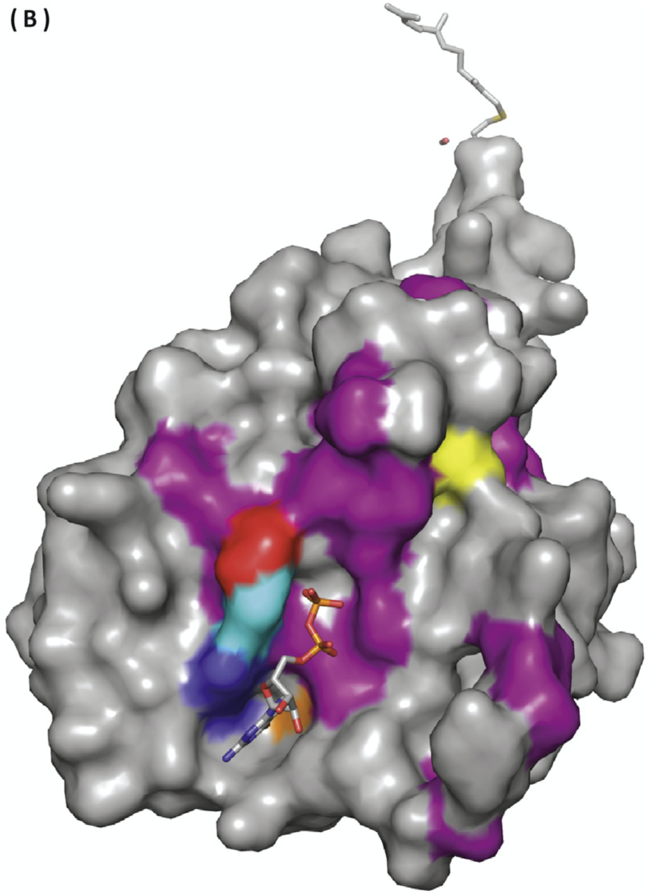
Various KRAS alleles drive cancer
Haigis, 2017
Notes:
Examples of differences between alleles: 1) structural/biochem, 2) signaling, 3) clinical

Slide 4
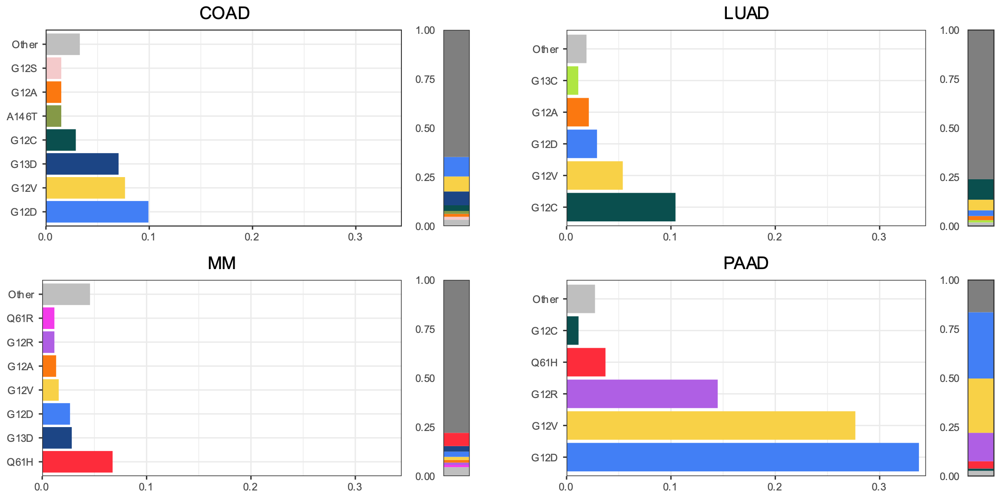
The distribution of alleles across cancers in uneven
Notes:
Barplot of allele frequencies

Slide 5
Are the KRAS mutations
caused by distinct mutational processes?
Notes:
Distribution of mutational signatures in the samples per allele

Slide 6
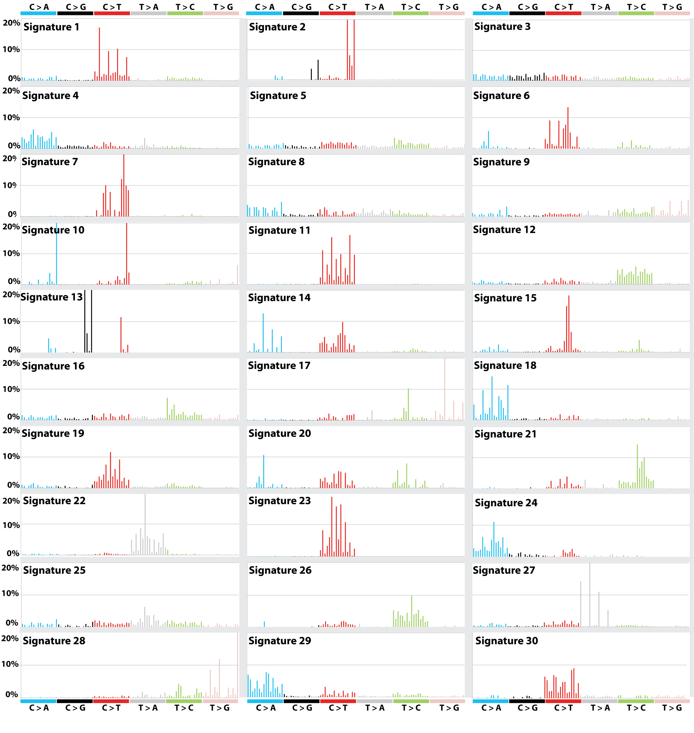
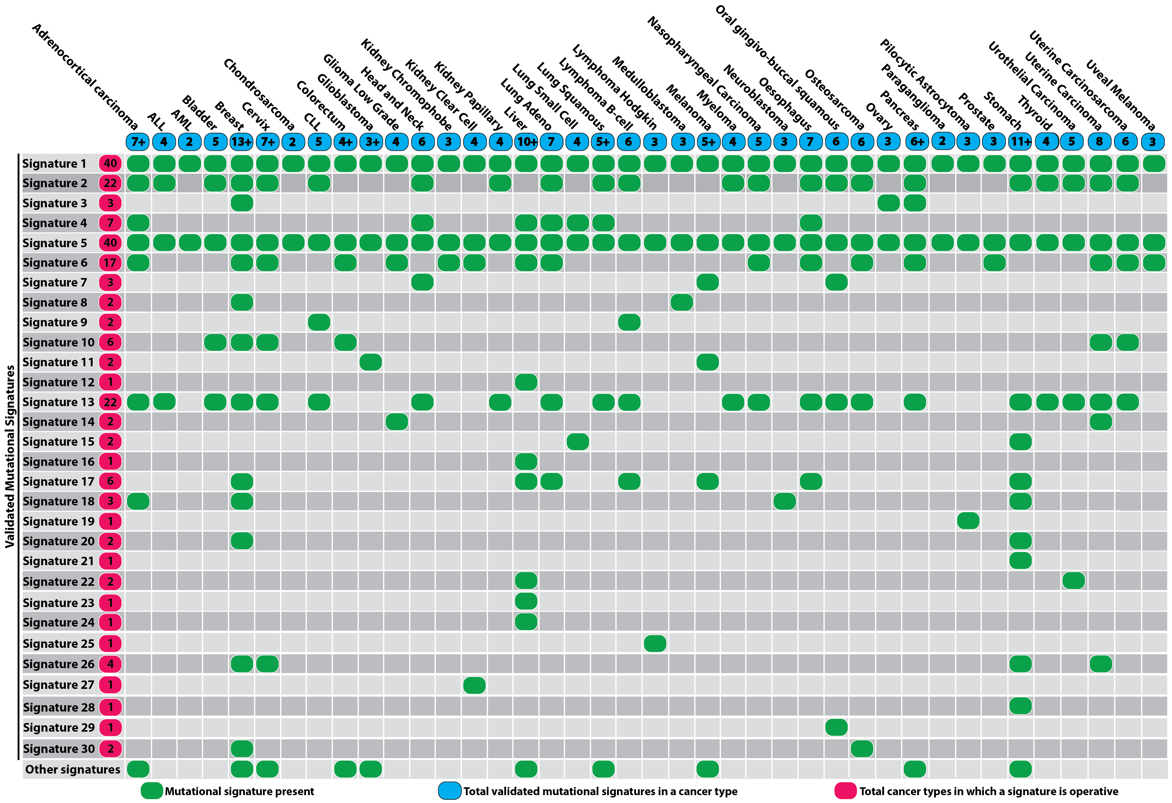
Active mutagens are identified by mutational signatures
Alexandrov et al., 2013; COSMIC
Notes:
BRIEF introduction to mutational signatures

Slide 7
Mutational signatures do not associate with alleles
COAD
LUAD
clock
smoke
clock
MUTYH
MM
PAAD
Pol η
Notes:
Distribution of mutational signatures in the samples per allele

Slide 8
Do the mutational signatures explain
the frequencies of the KRAS alleles?
Notes:
Distribution of mutational signatures in the samples per allele

Slide 9
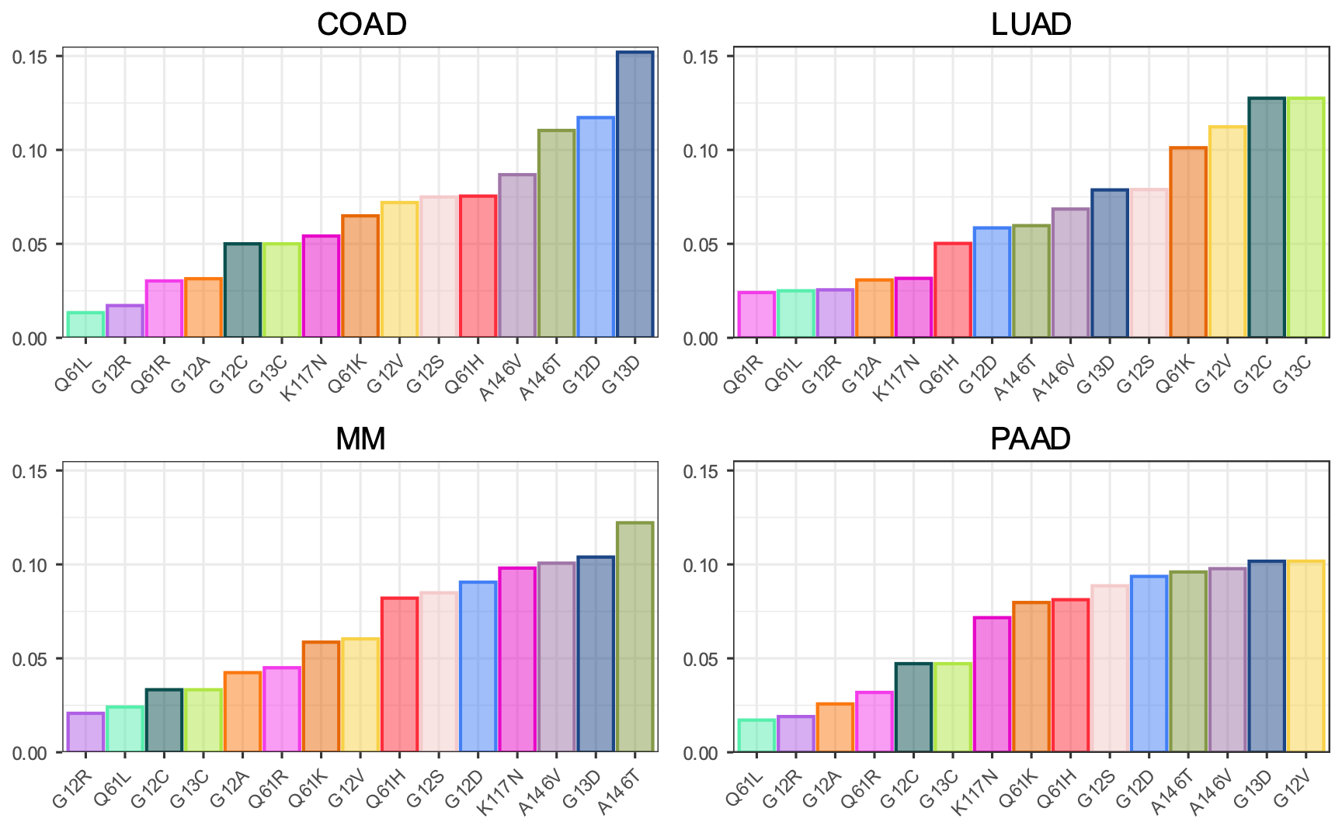
Mutational signatures are not fully explanatory
predicted KRAS allele frequency
Notes:
Observed vs. predicted bar plots
Make alternative versions:
arranged by prediction value and colored by the real ranking
arranged by prediction value and color just G12 (I think G12’s are not as highly predicted as they should be)
Weight the contribution of each prediction value by the (log of) number of mutations in the sample.

Slide 10
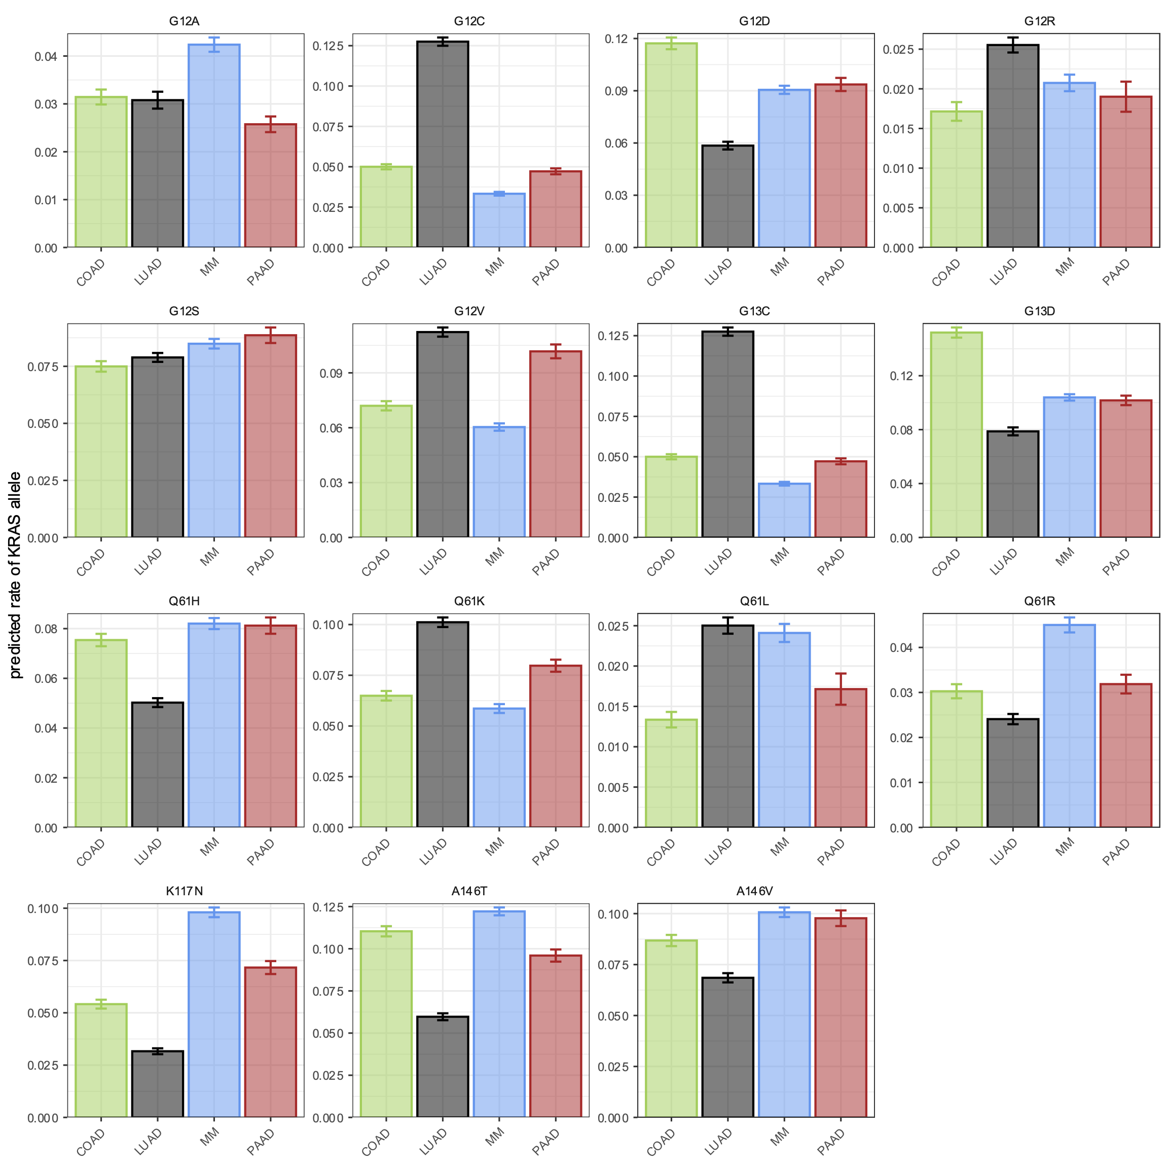
Mutational signatures are not fully explanatory
predicted KRAS allele frequency
Notes:
Observed vs. predicted bar plots
Make alternative versions:
arranged by prediction value and colored by the real ranking
arranged by prediction value and color just G12 (I think G12’s are not as highly predicted as they should be)
Weight the contribution of each prediction value by the (log of) number of mutations in the sample.

Slide 11
Mutational signatures are not fully explanatory
Notes:
Observed vs. predicted bar plots
Make alternative versions:
arranged by prediction value and colored by the real ranking
arranged by prediction value and color just G12 (I think G12’s are not as highly predicted as they should be)
Weight the contribution of each prediction value by the (log of) number of mutations in the sample.

Slide 12
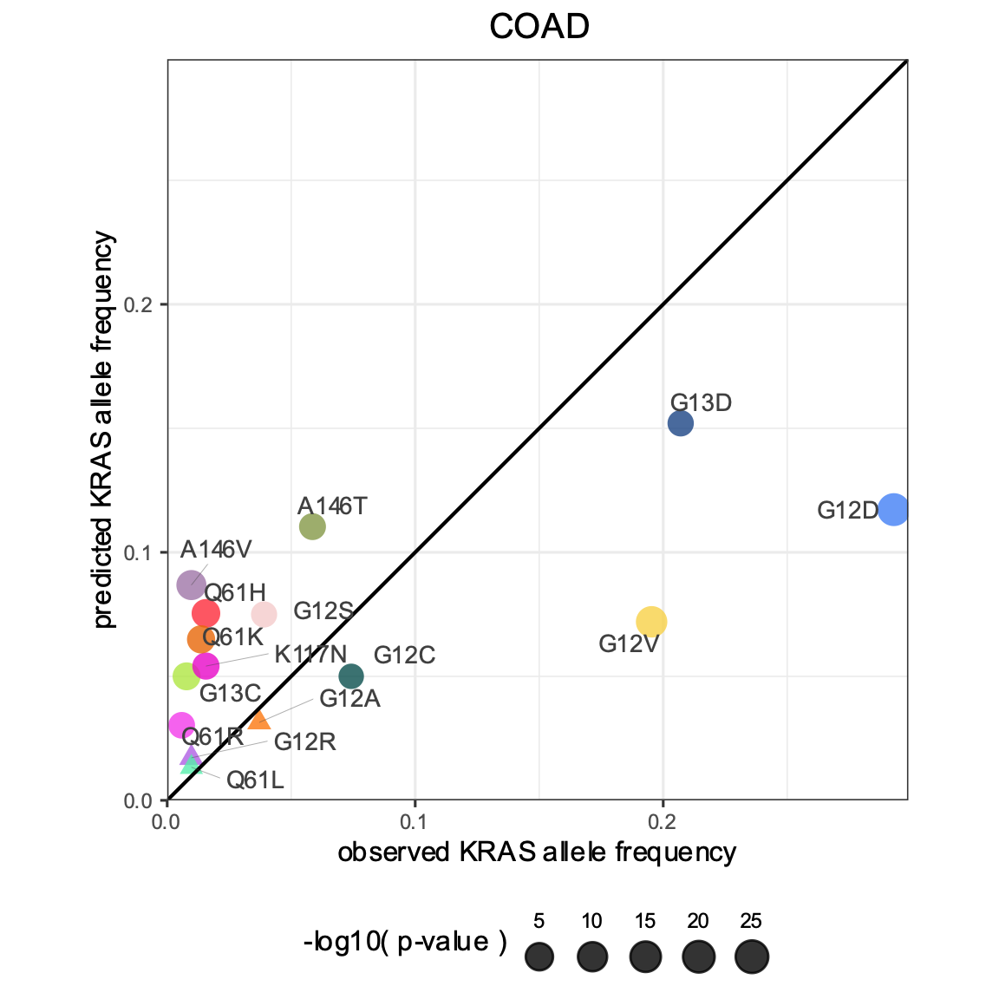
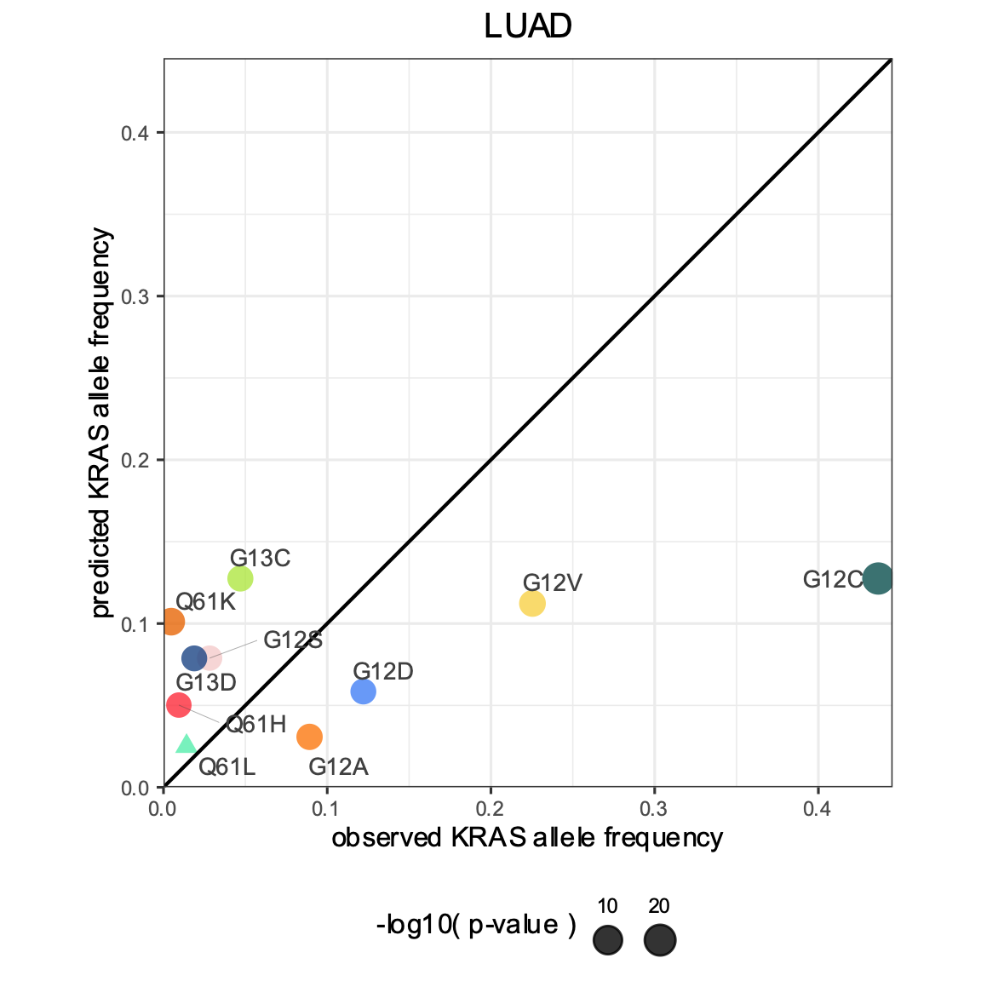
Mutational signatures are not fully explanatory
Less frequent than predicted
More frequent than predicted
Notes:
Observed vs. predicted scatter plots
Conclusion: The allele is not solely determined by the active mutational process in a tumor.
Segue: Therefore, the genetic interactions of the KRAS alleles warrant further investigation.

Slide 13
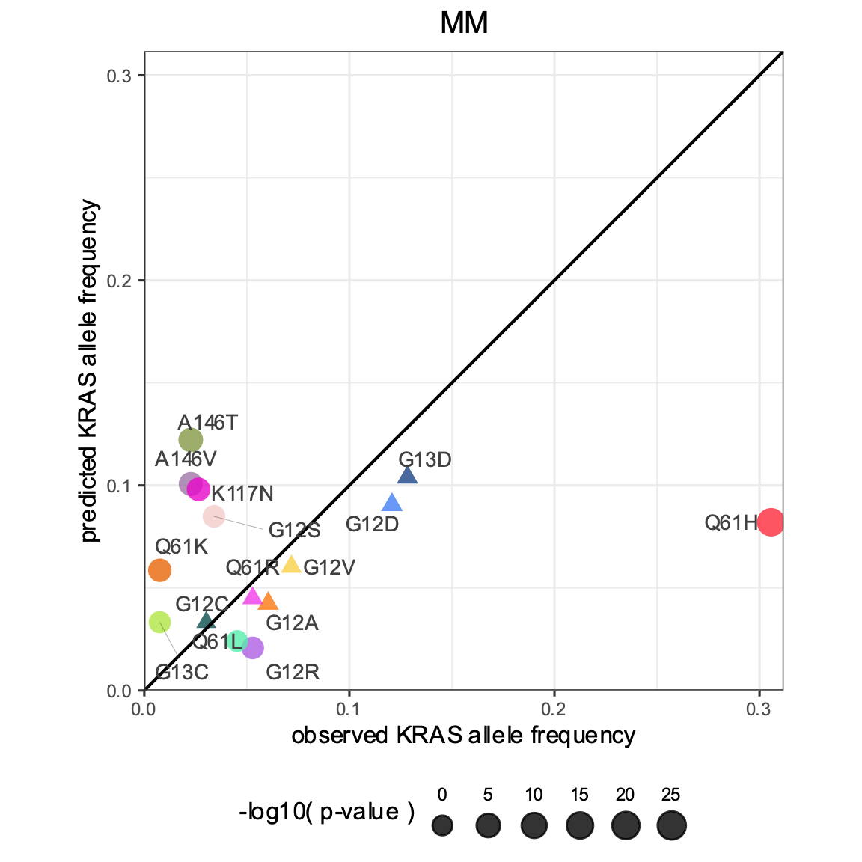
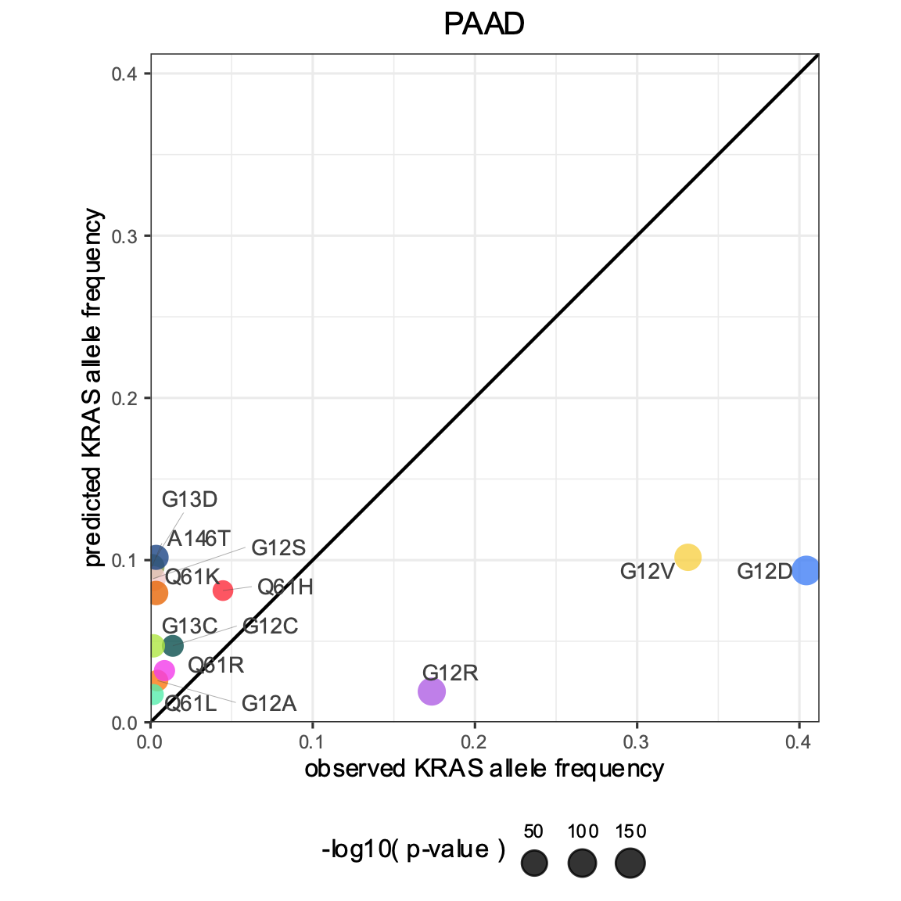
Mutational signatures are not fully explanatory
Less frequent than predicted
More frequent than predicted
Notes:
Observed vs. predicted scatter plots
Conclusion: The allele is not solely determined by the active mutational process in a tumor.
Segue: Therefore, the genetic interactions of the KRAS alleles warrant further investigation.

Slide 14
Mutational signatures are not fully explanatory
Notes:
Observed vs. predicted scatter plots
Conclusion: The allele is not solely determined by the active mutational process in a tumor.
Segue: Therefore, the genetic interactions of the KRAS alleles warrant further investigation.

Slide 15
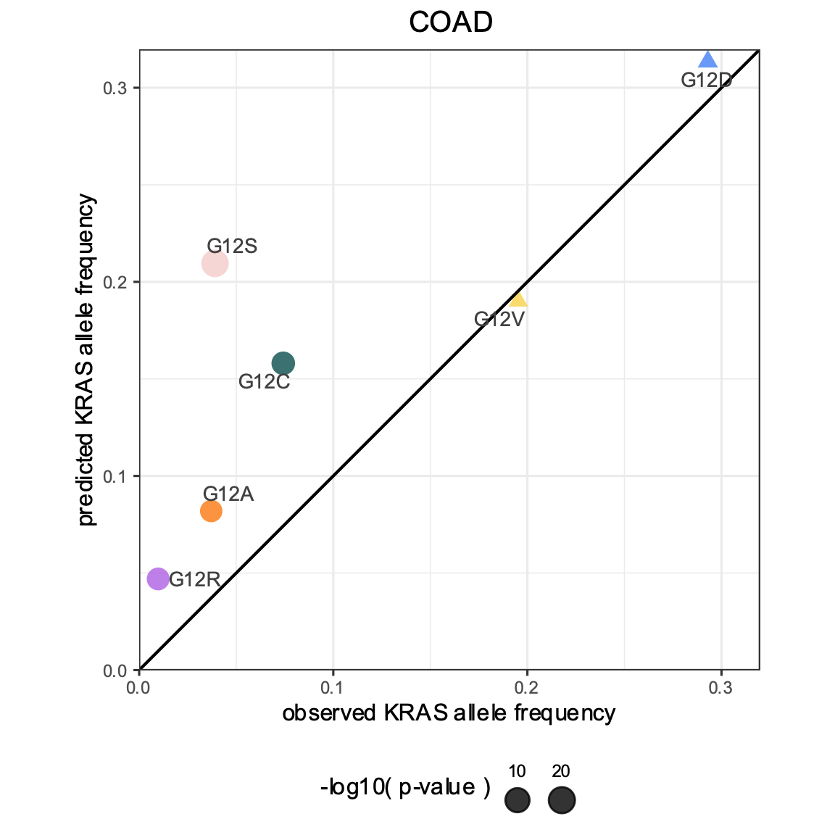
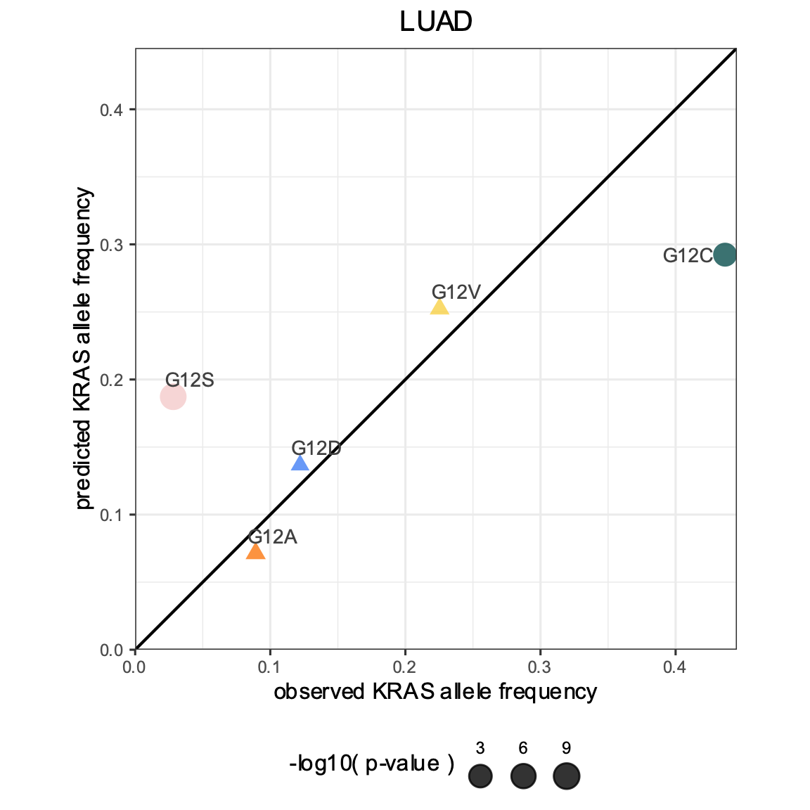
Mutational signatures are not fully explanatory
Less frequent than predicted
More frequent than predicted
Notes:
Observed vs. predicted scatter plots
Conclusion: The allele is not solely determined by the active mutational process in a tumor.
Segue: Therefore, the genetic interactions of the KRAS alleles warrant further investigation.

Slide 16
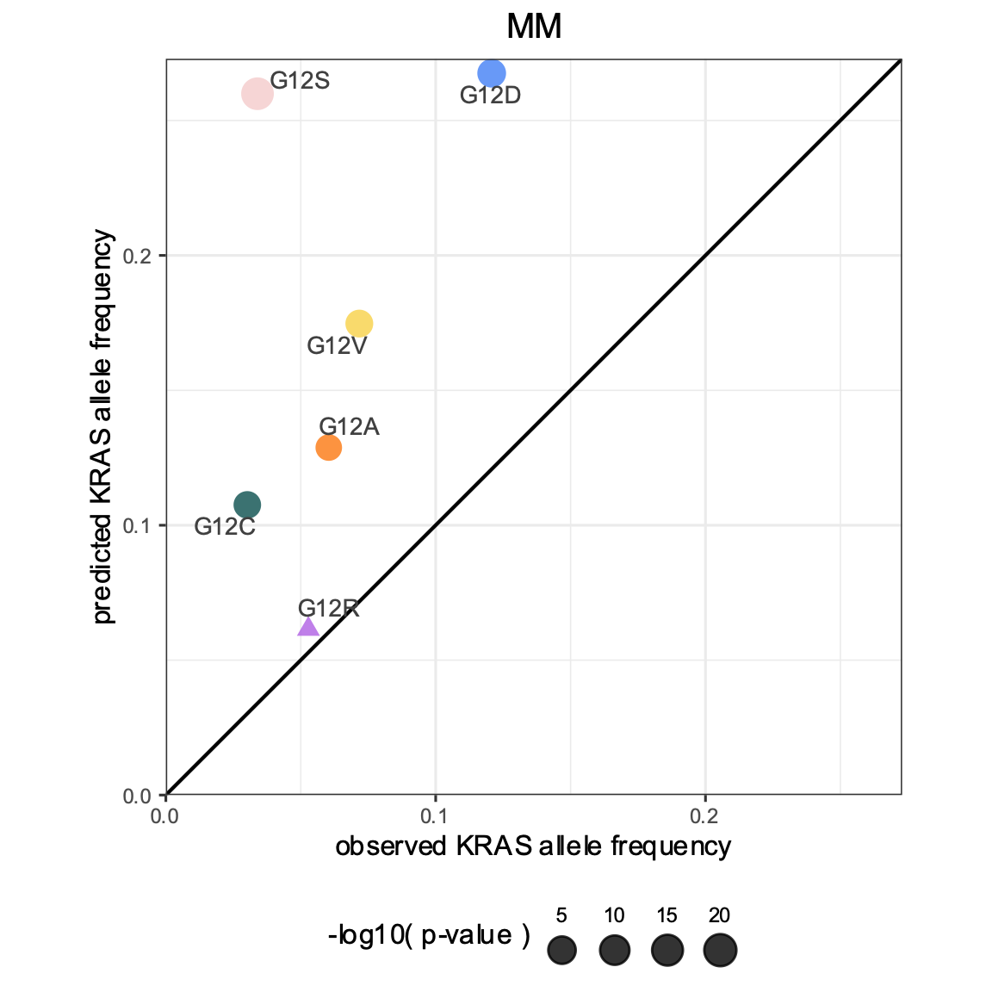
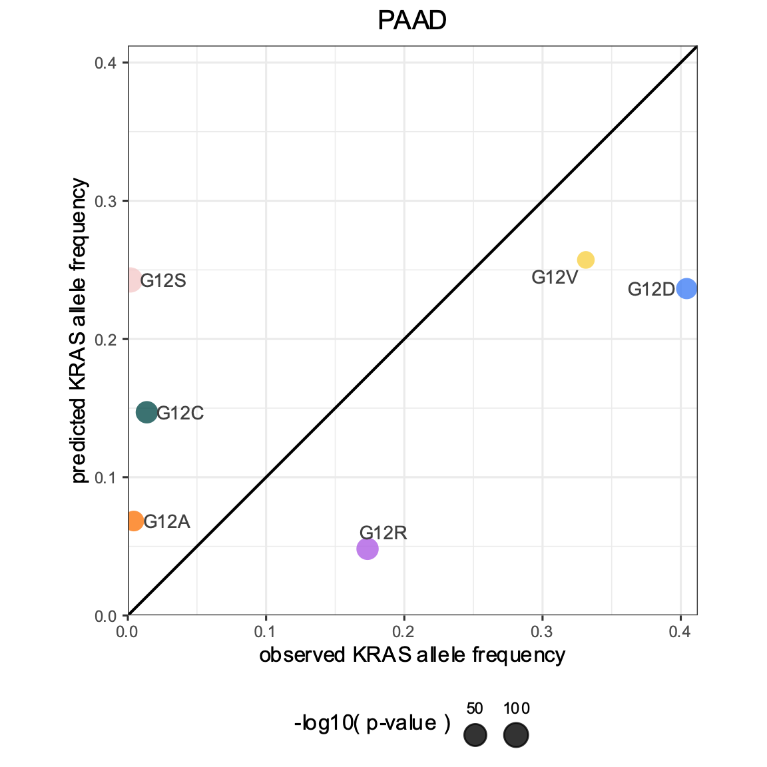
Mutational signatures are not fully explanatory
Less frequent than predicted
More frequent than predicted
Notes:
Observed vs. predicted scatter plots
Conclusion: The allele is not solely determined by the active mutational process in a tumor.
Segue: Therefore, the genetic interactions of the KRAS alleles warrant further investigation.

Slide 17
Mutational signatures are not fully explanatory
Notes:
Observed vs. predicted scatter plots
Conclusion: The allele is not solely determined by the active mutational process in a tumor.
Segue: Therefore, the genetic interactions of the KRAS alleles warrant further investigation.

Slide 18
Do the KRAS alleles have
comutation interactions?
Notes:
Distribution of mutational signatures in the samples per allele

Slide 19
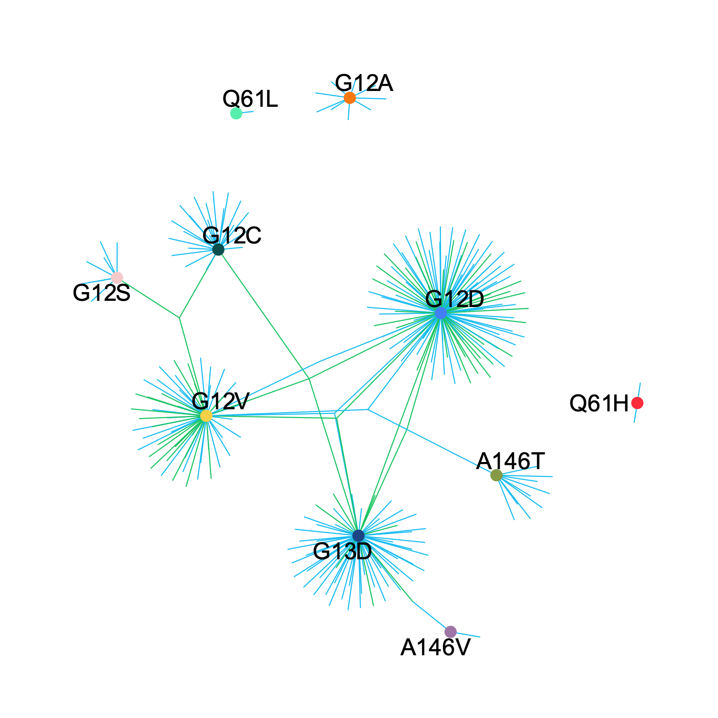
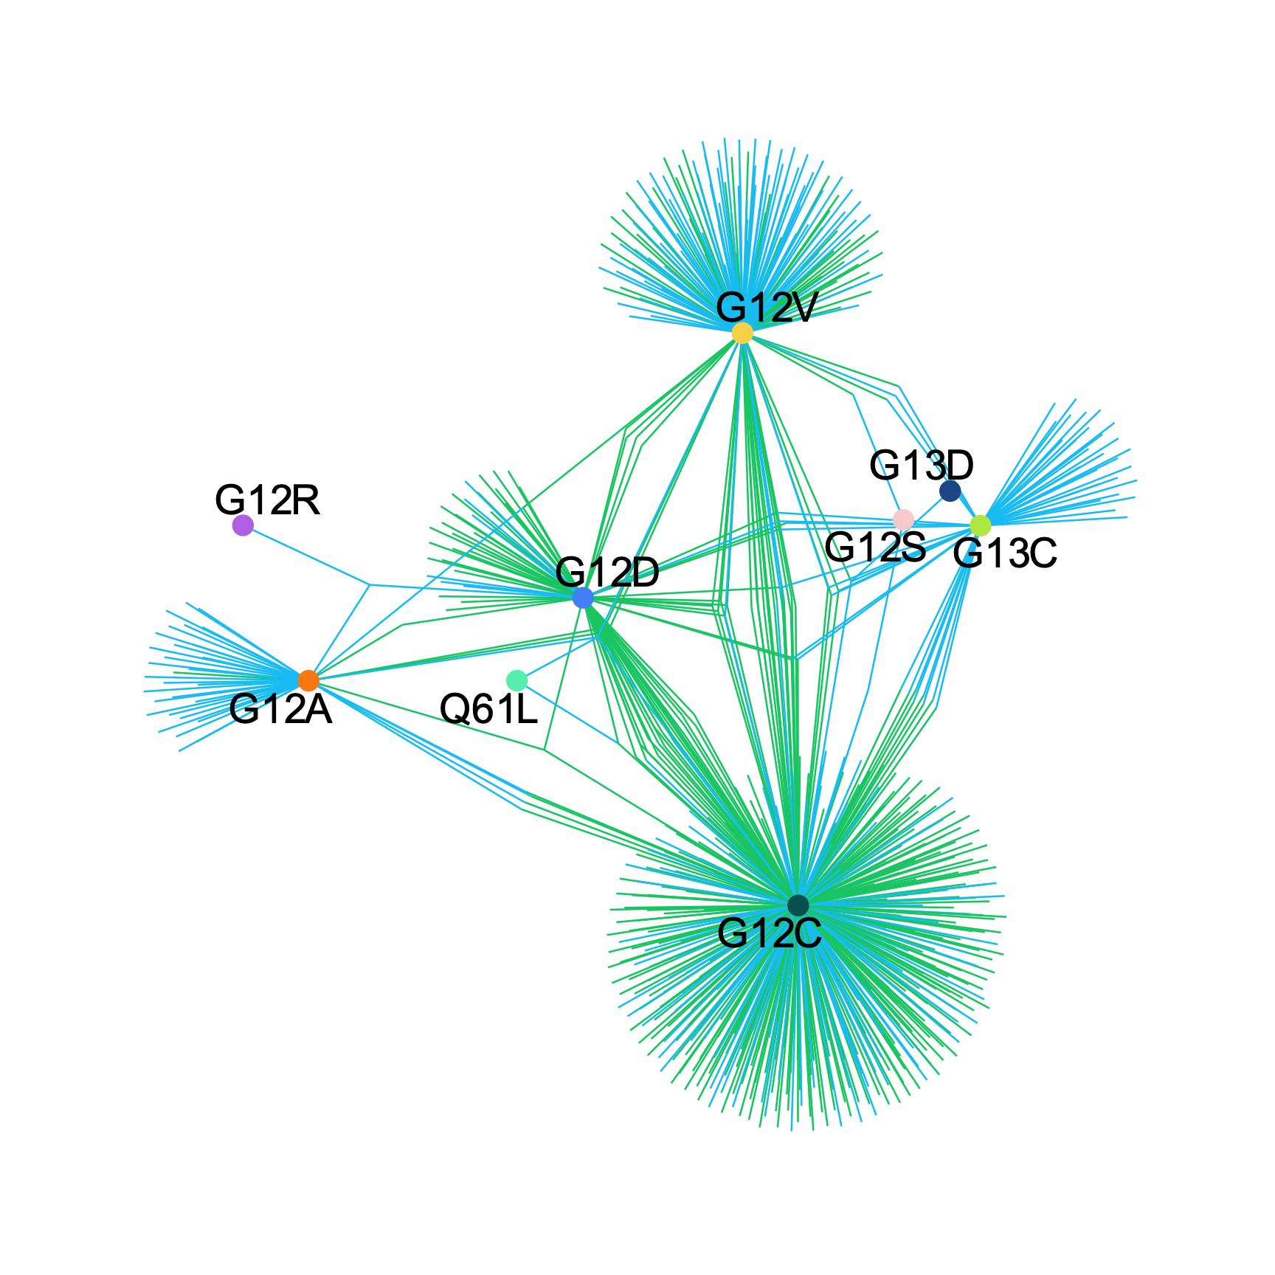
Most shared interactions are reduced comutations
COAD
LUAD
increased comutation
reduced comutation

Slide 20
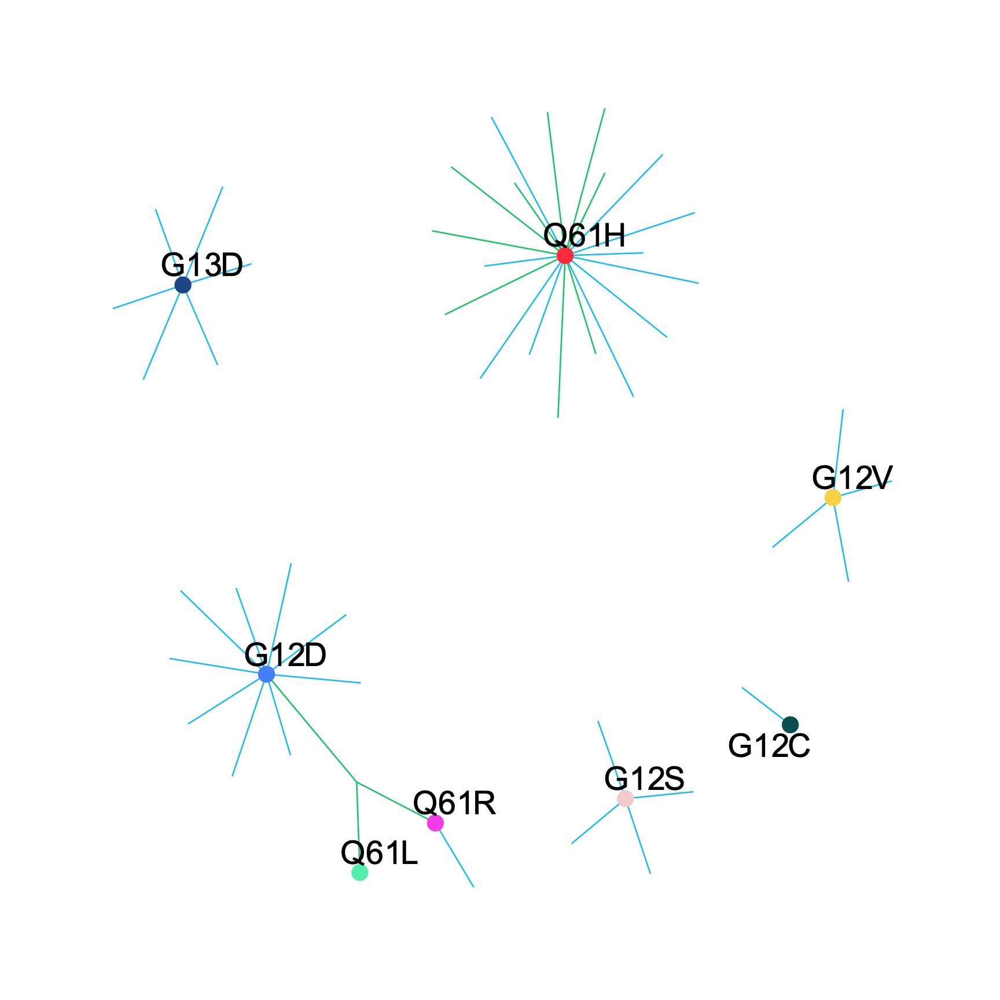
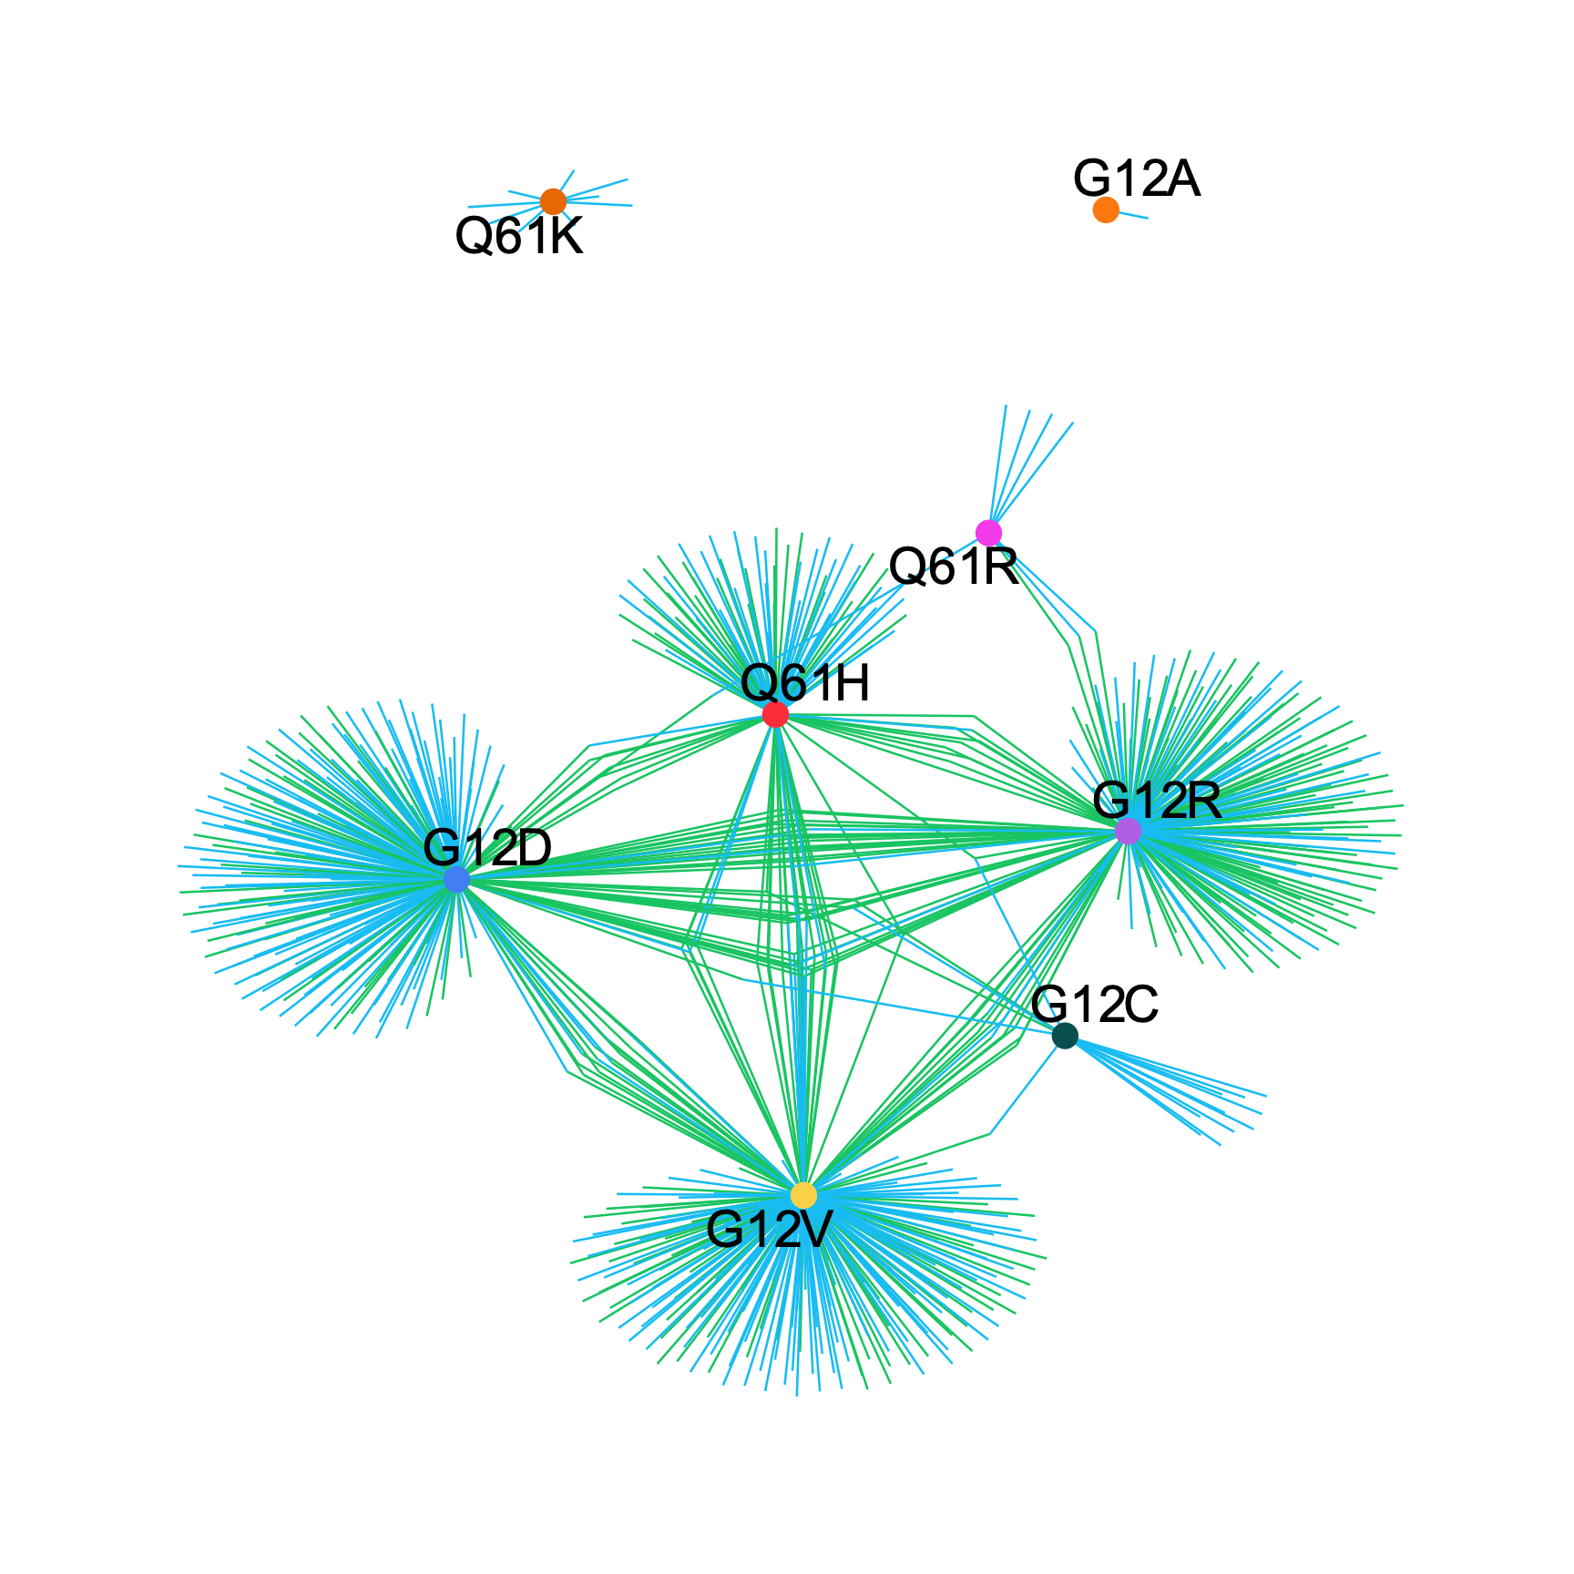
Most shared interactions are reduced comutations
MM
PAAD
increased comutation
reduced comutation

Slide 21
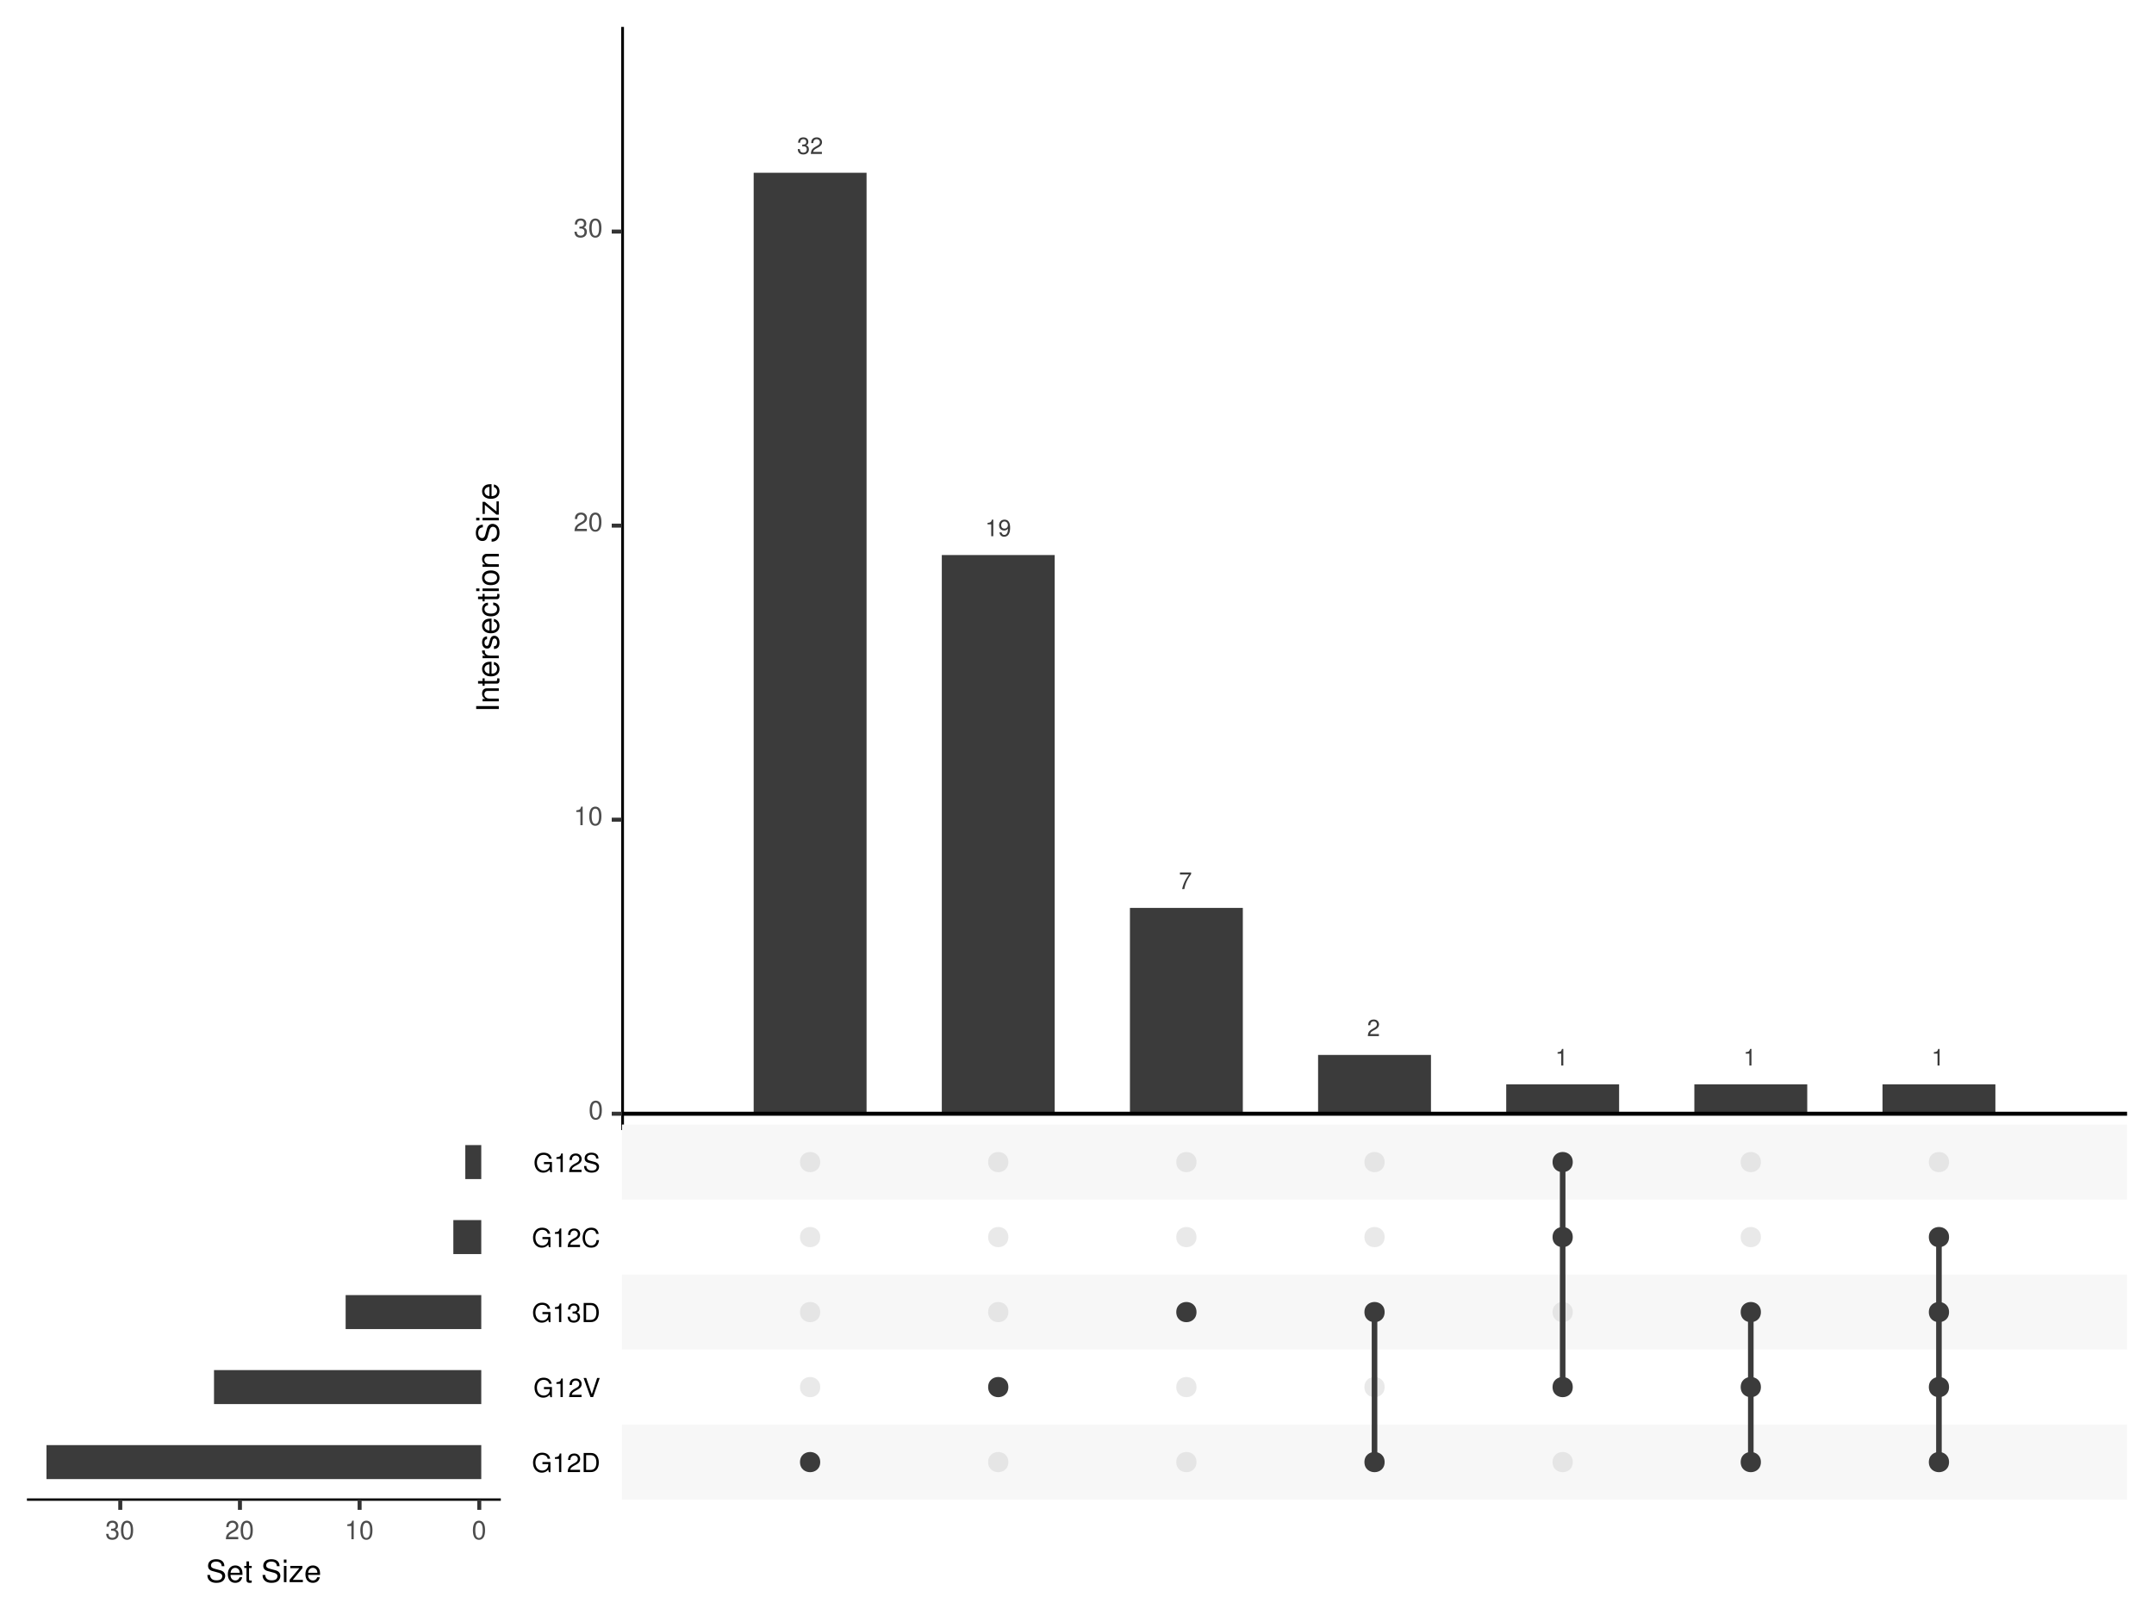
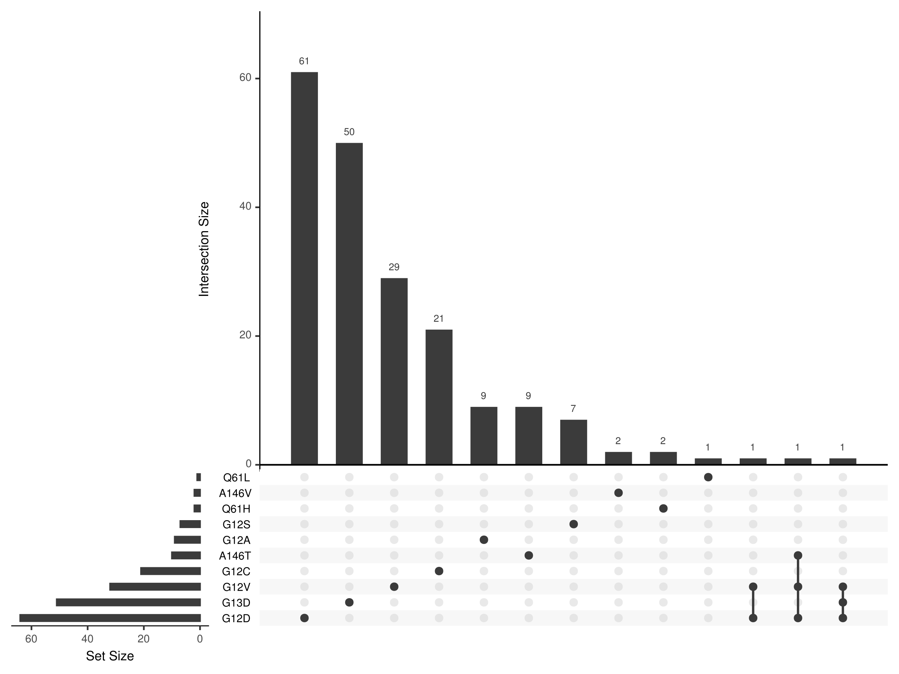
COAD
increased comutation
reduced comutation

Slide 22
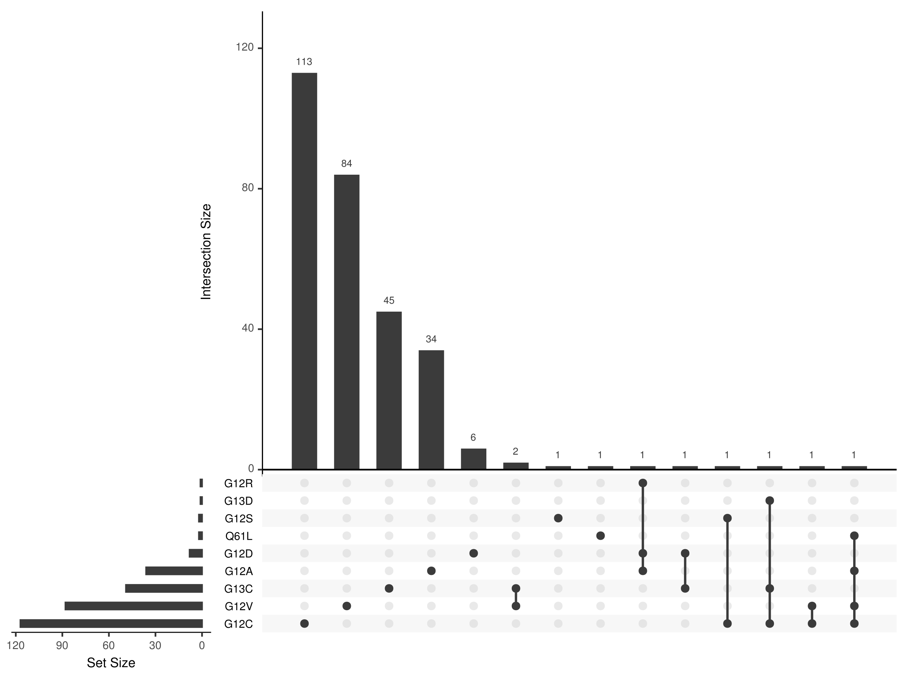
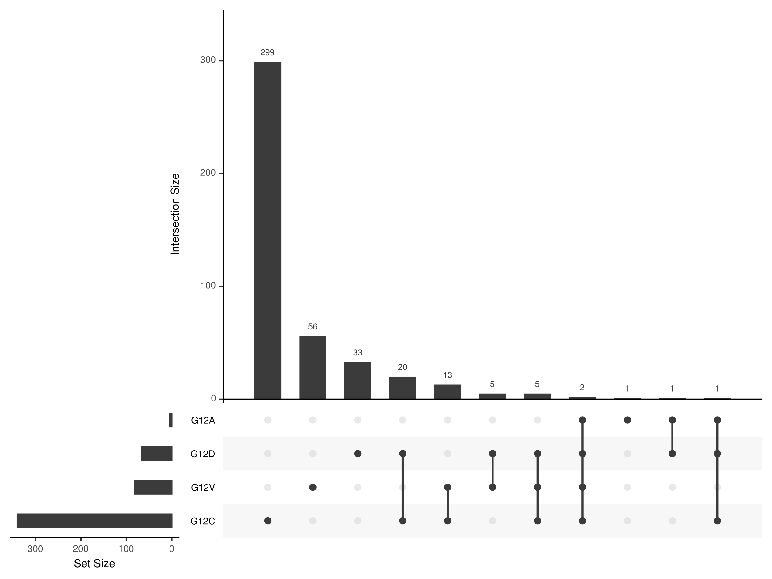
LUAD
increased comutation
reduced comutation

Slide 23
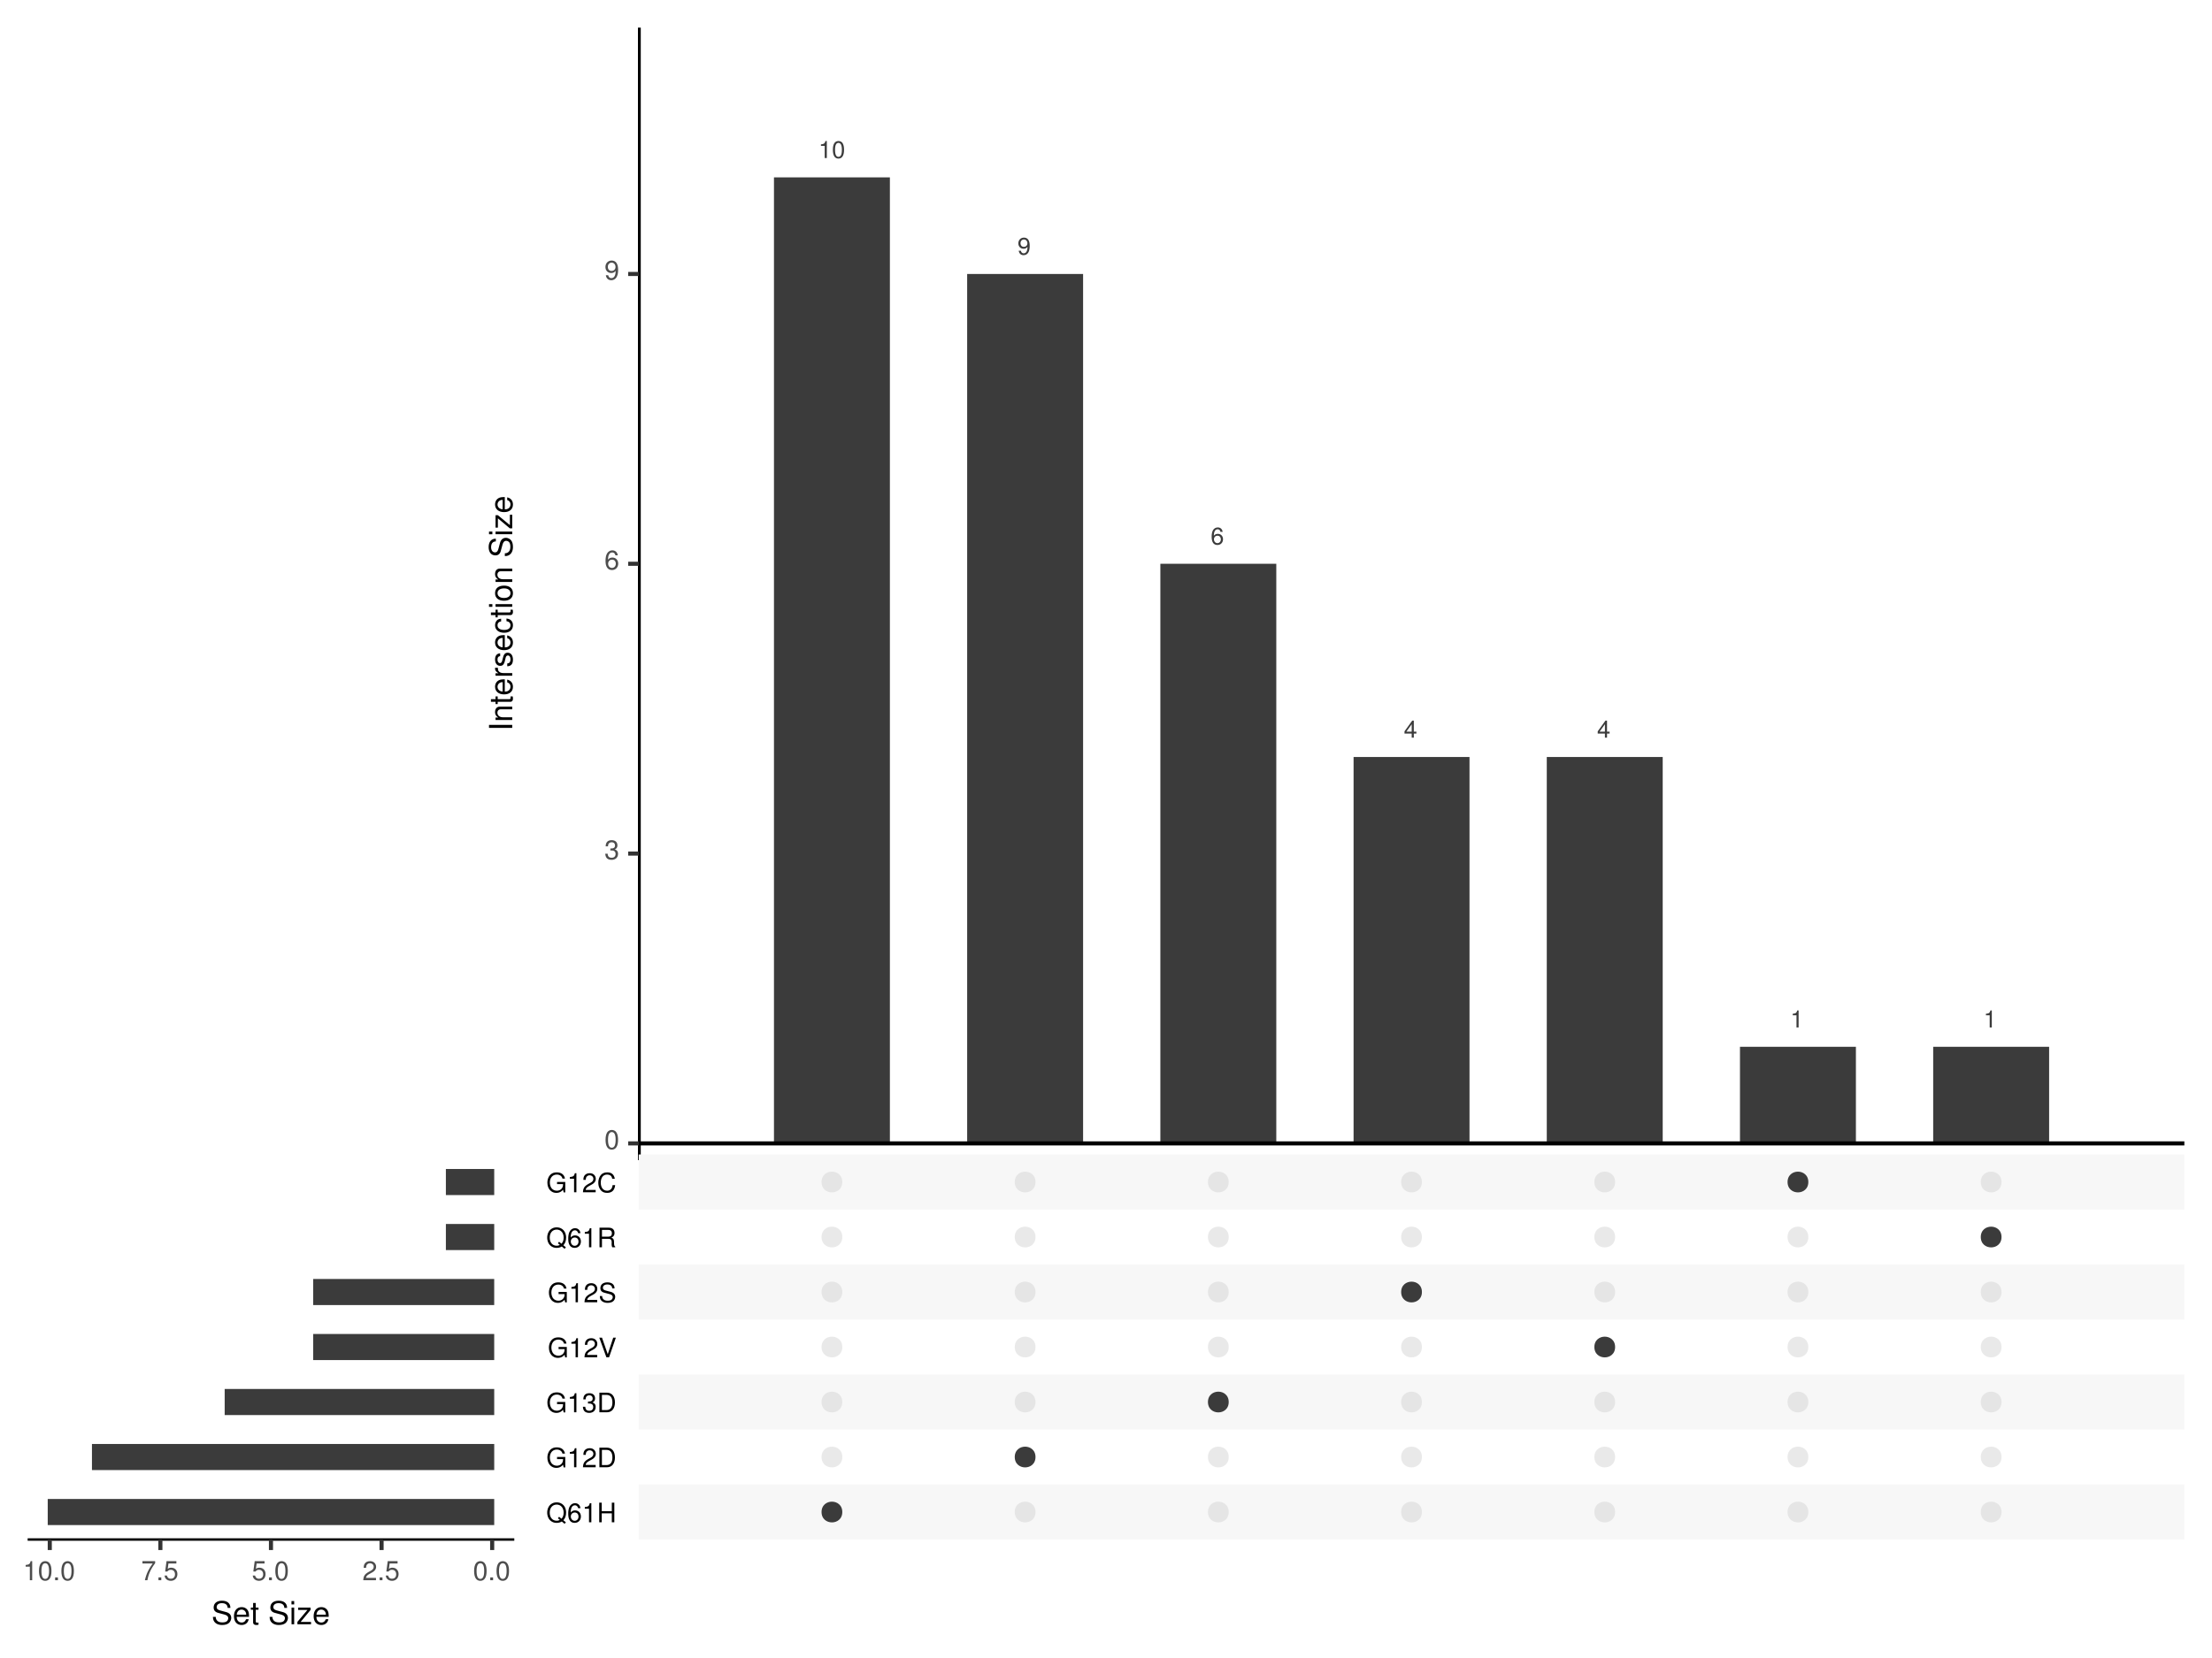
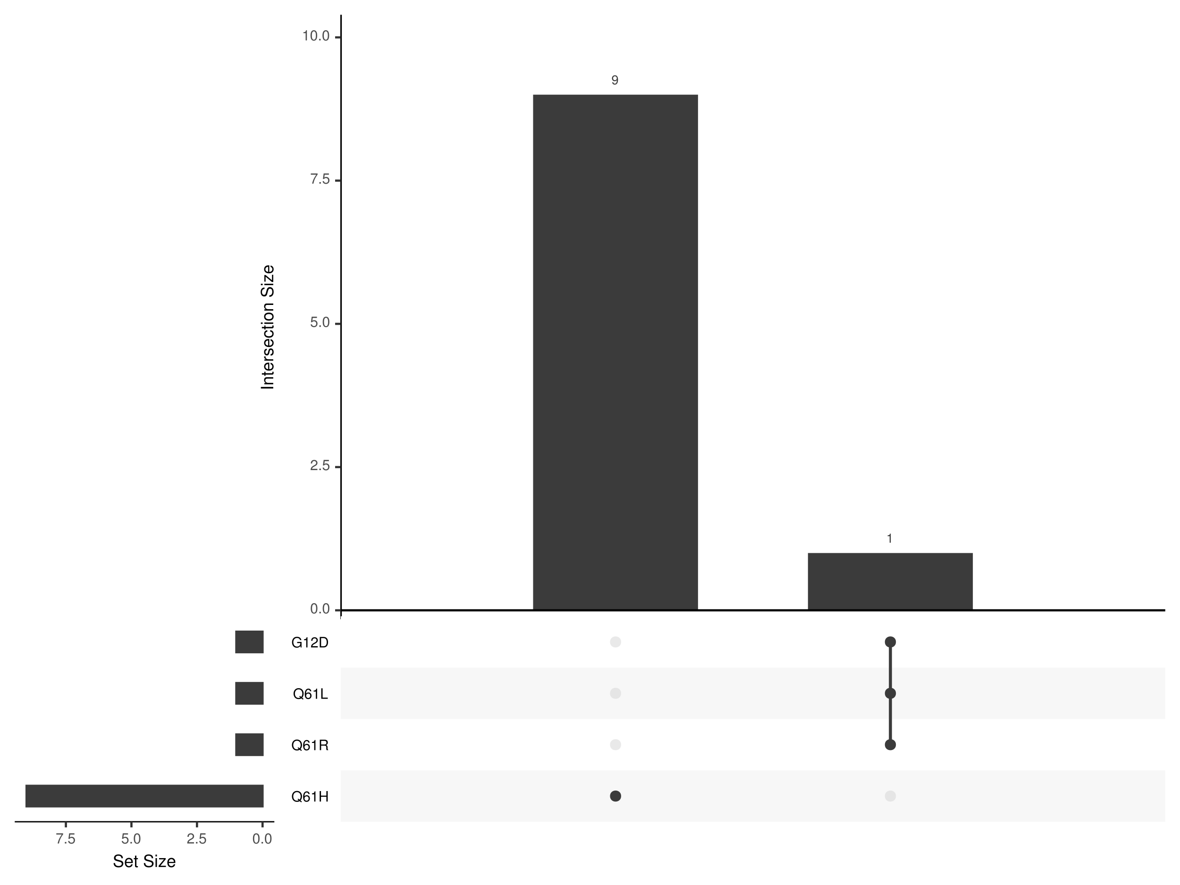
MM
increased comutation
reduced comutation

Slide 24
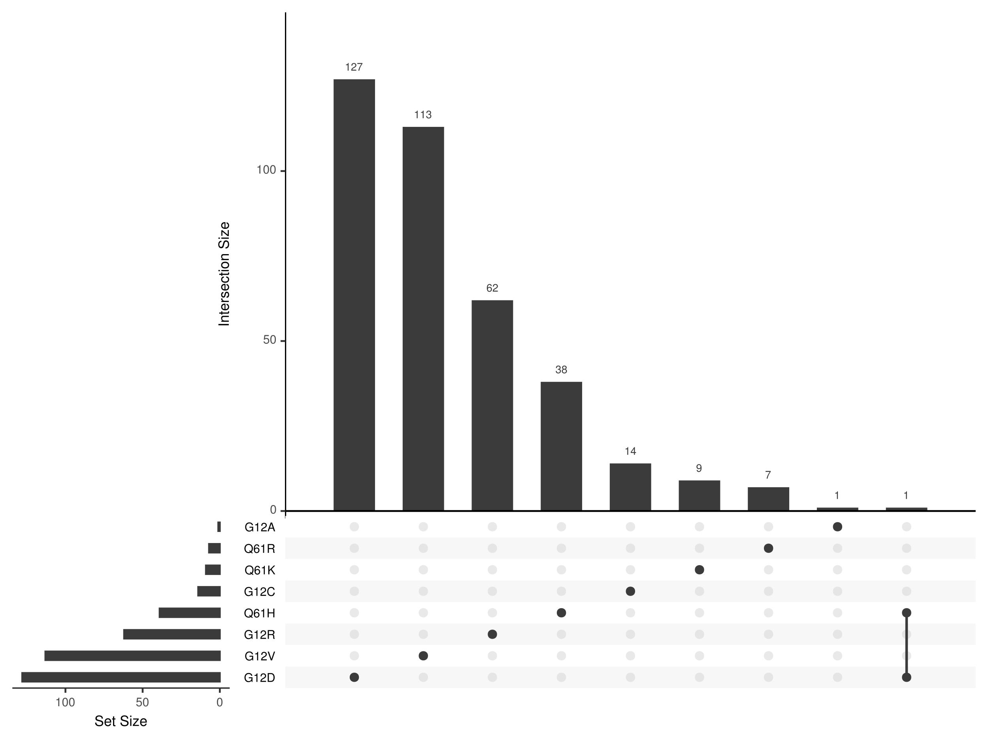
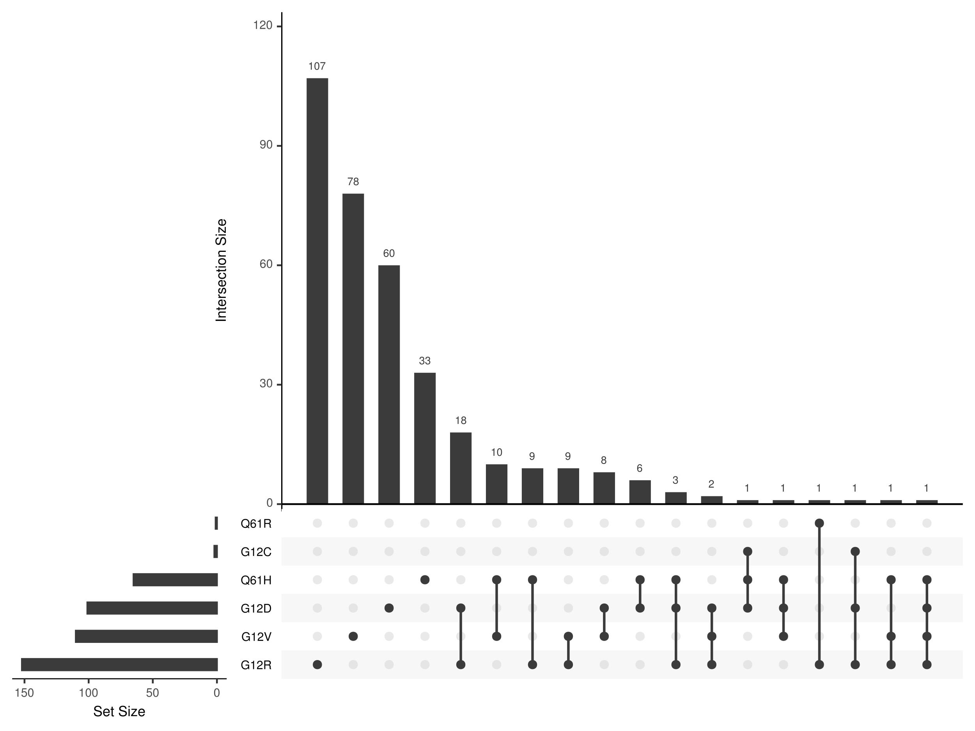
PAAD
increased comutation
reduced comutation

Slide 25
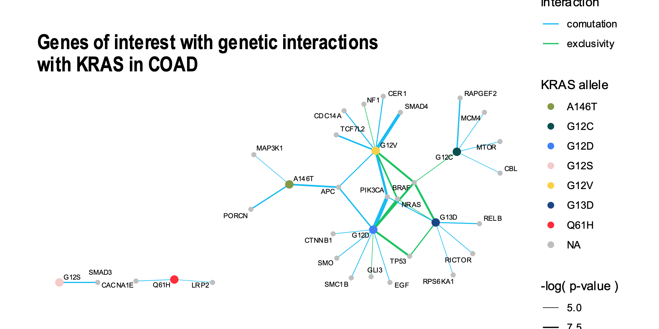
Comutation interactions in COAD
increased comutation
reduced comutation

Slide 26
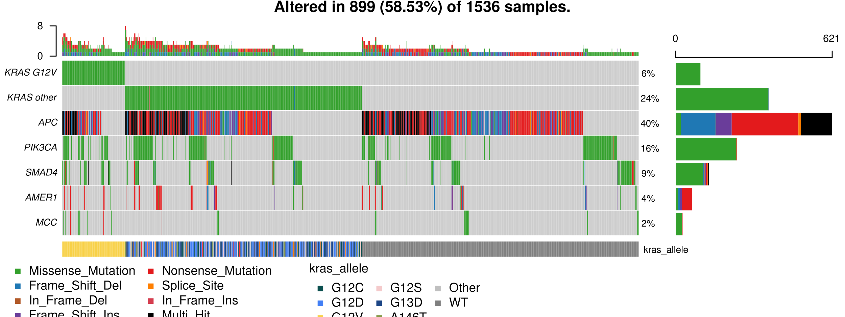
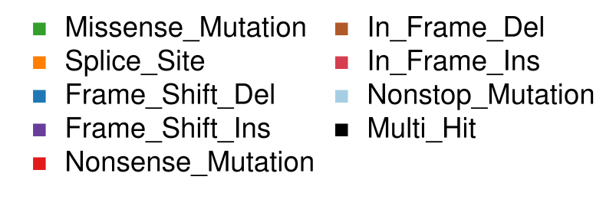
G12V comutation interactions in COAD
increased comutation
reduced comutation
Notes:
SMAD4: required for transcriptional response to TGF
AMER1: “APC membrane recruitment protein 1”; regulation of Wnt
MCC: suppresses cell proliferation and Wnt pathway

Slide 27
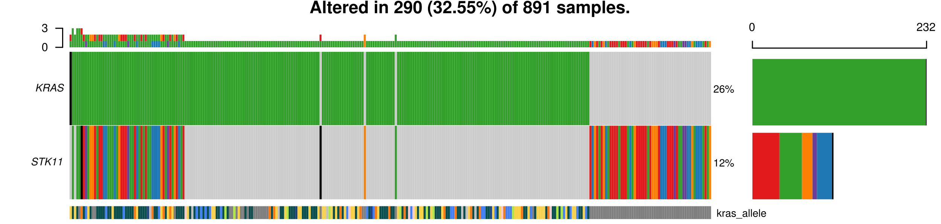
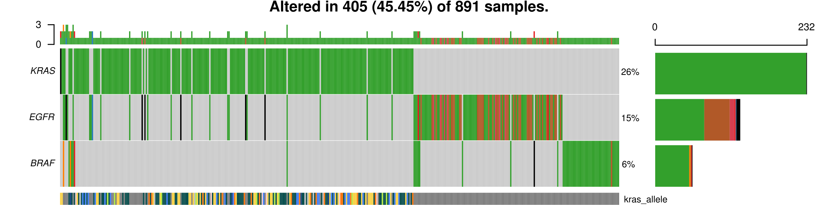
Comutation interactions in LUAD

Slide 28
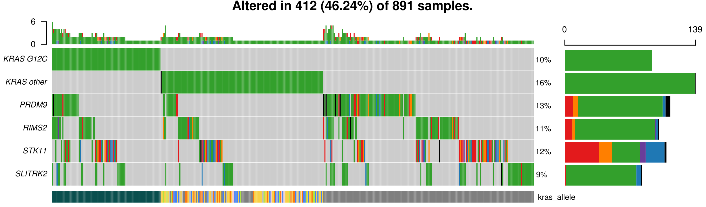
Comutation interactions in LUAD
Notes:
PRDM9: histone methyltransferase; part of DSB repair
RIMS2: Rab effector involved in exocytosis
SLITRK2: involved in synaptogenesis

Slide 29
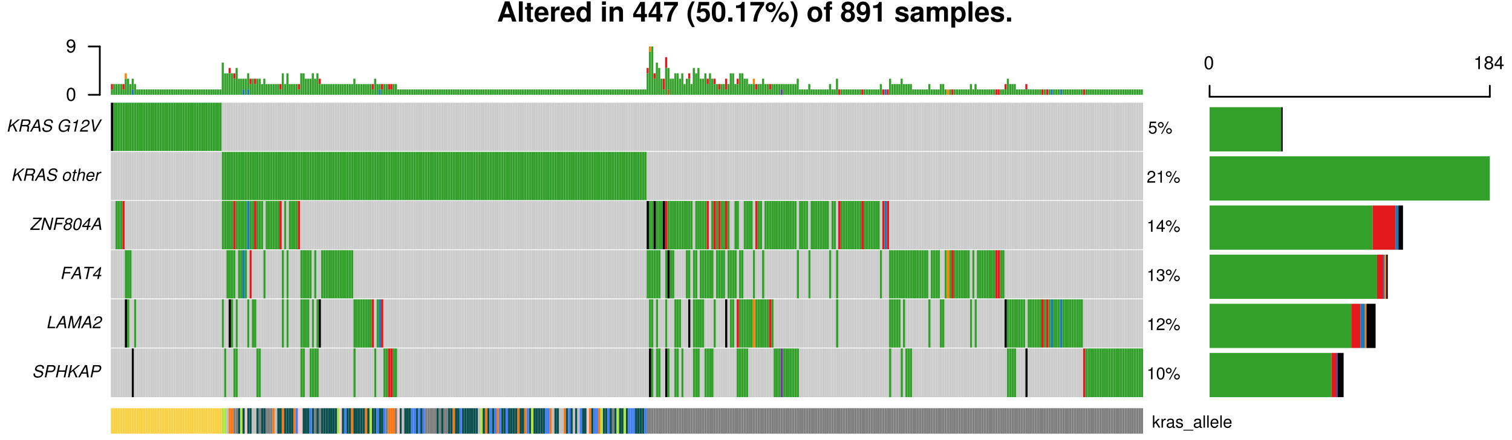
Comutation interactions in LUAD
Notes:
FAT4: cadherin; calcium-dependent cell adhesion; regulates cell polarity; inhibition of YAP1-mediated proliferation
LAMA2: component of the ECM; important for tissue organization during development
SPHKAP: linking protein for c-AMP dependent kinase 1 (PKA type I); linking cAMP and sphingosine signaling pathways

Slide 30
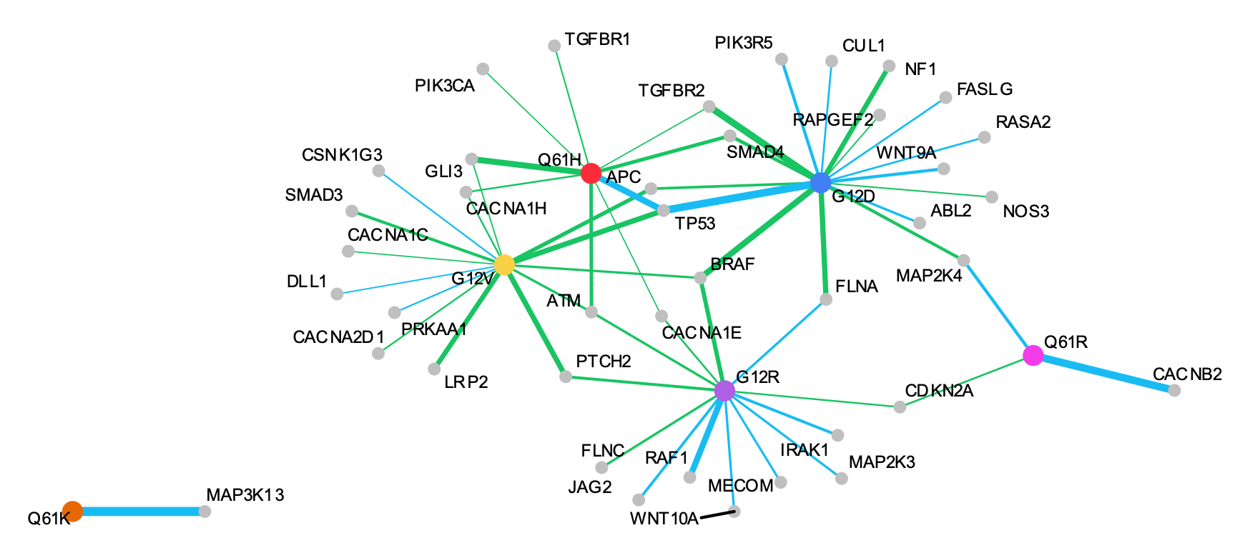
Comutation interactions in PAAD
TP53
increased comutation
reduced comutation

Slide 31
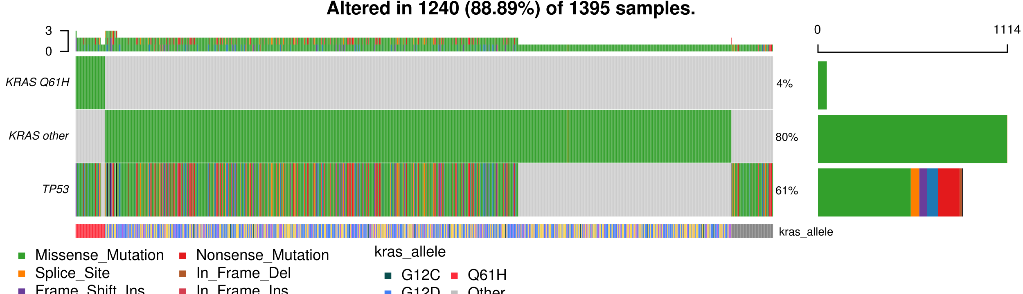
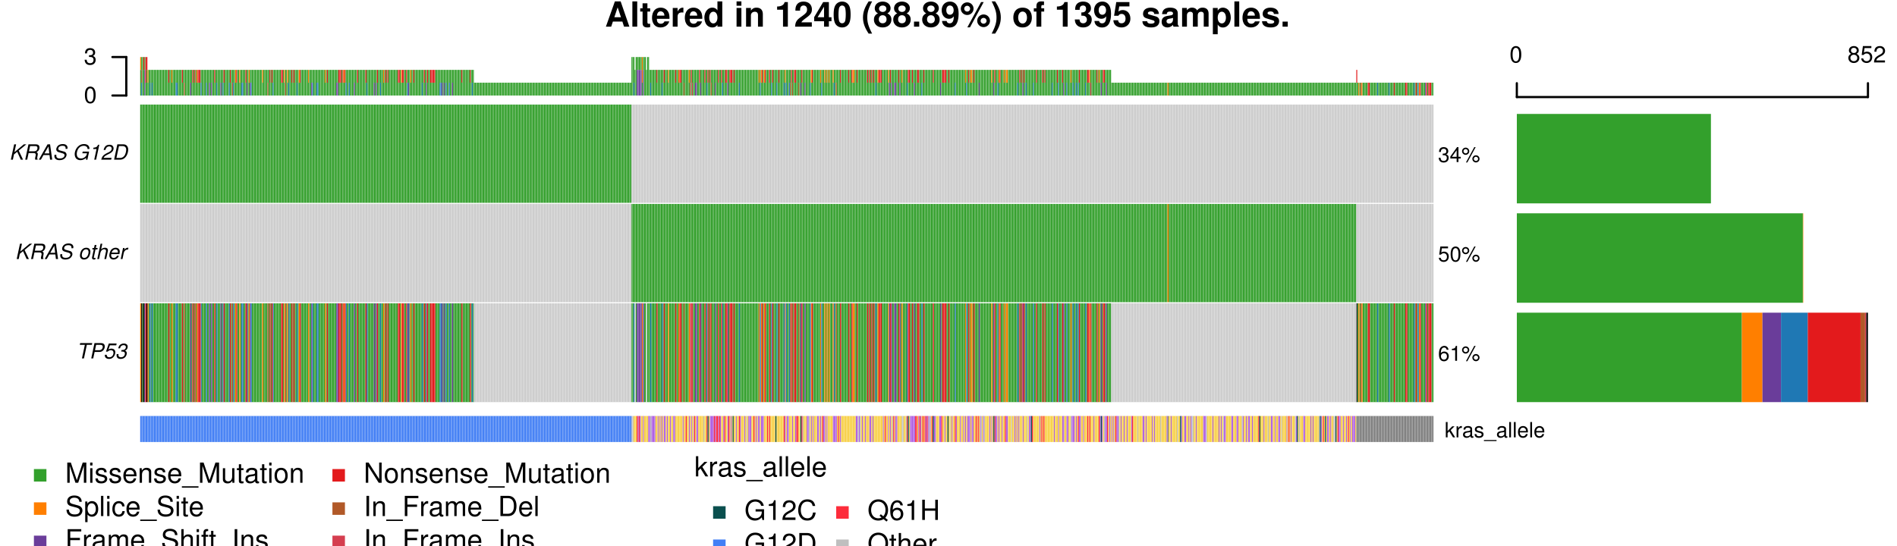
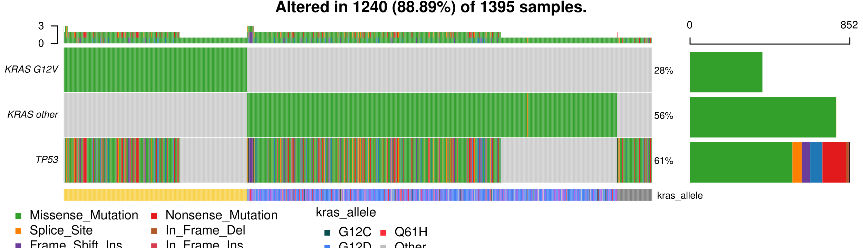
Comutation interactions in PAAD
Allele | Comutation rate
total | 63 %
WT | 34 %
KRAS mut. | 68 %
Q61H | 87 %
G12D | 70 %
G12V | 64 %

Slide 32
Are there allele-specific
genetic dependencies?
Notes:
Distribution of mutational signatures in the samples per allele

Slide 33
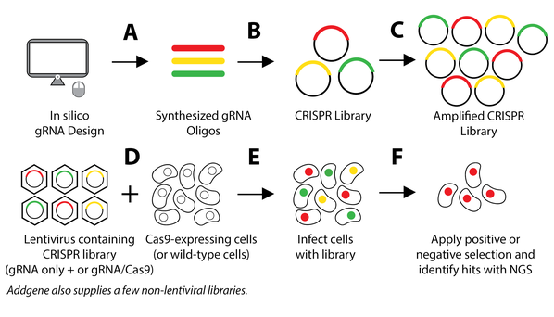

Achilles: a genome-wide CRISPR-Cas9 knock-out screen
data source:
“CRISPR Guide,” Addgene

Slide 34
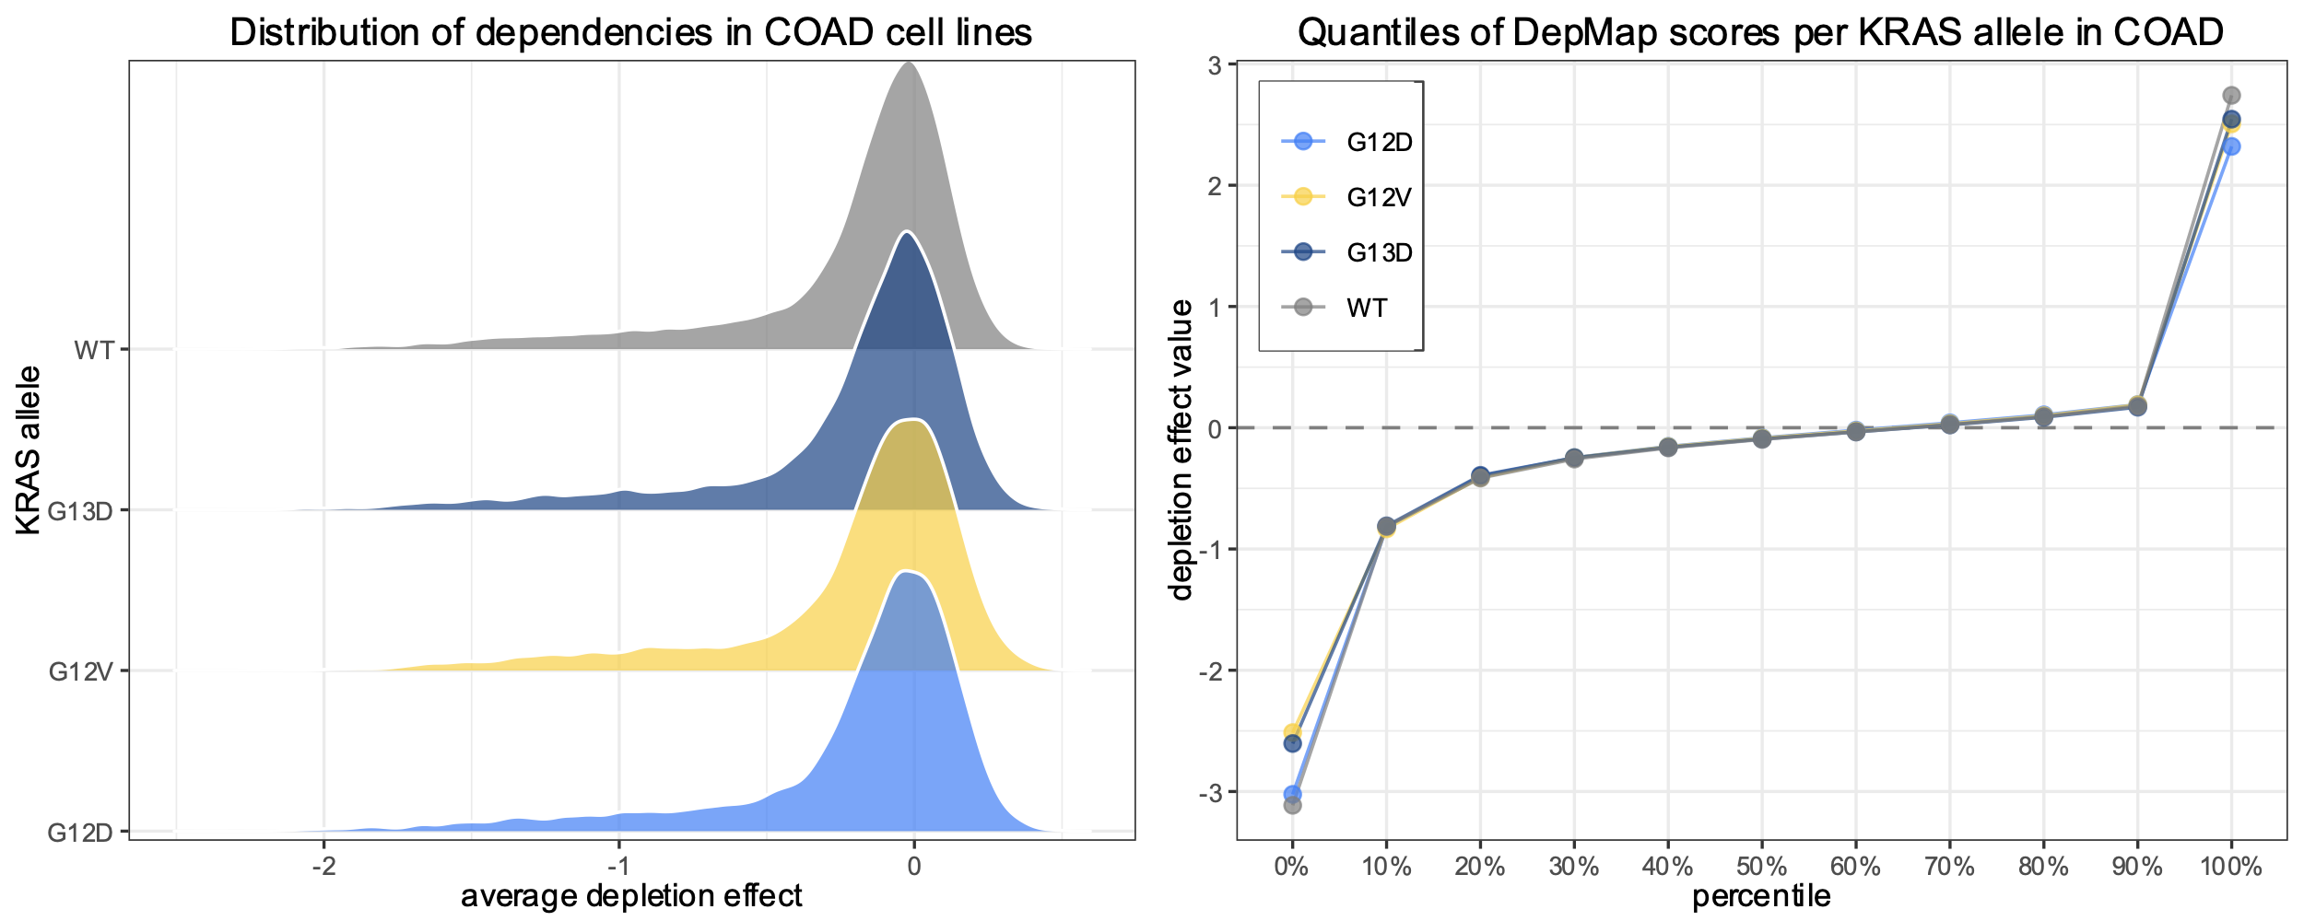
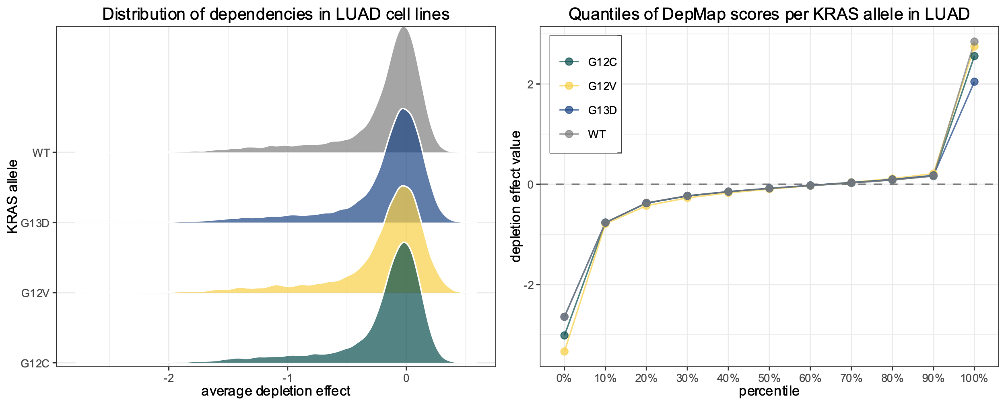
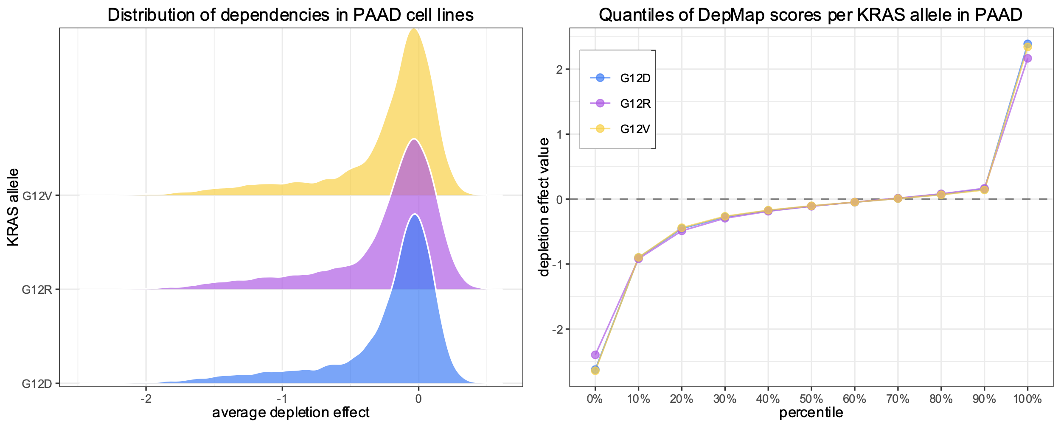
No systemic bias of DepMap scores per allele

Slide 35
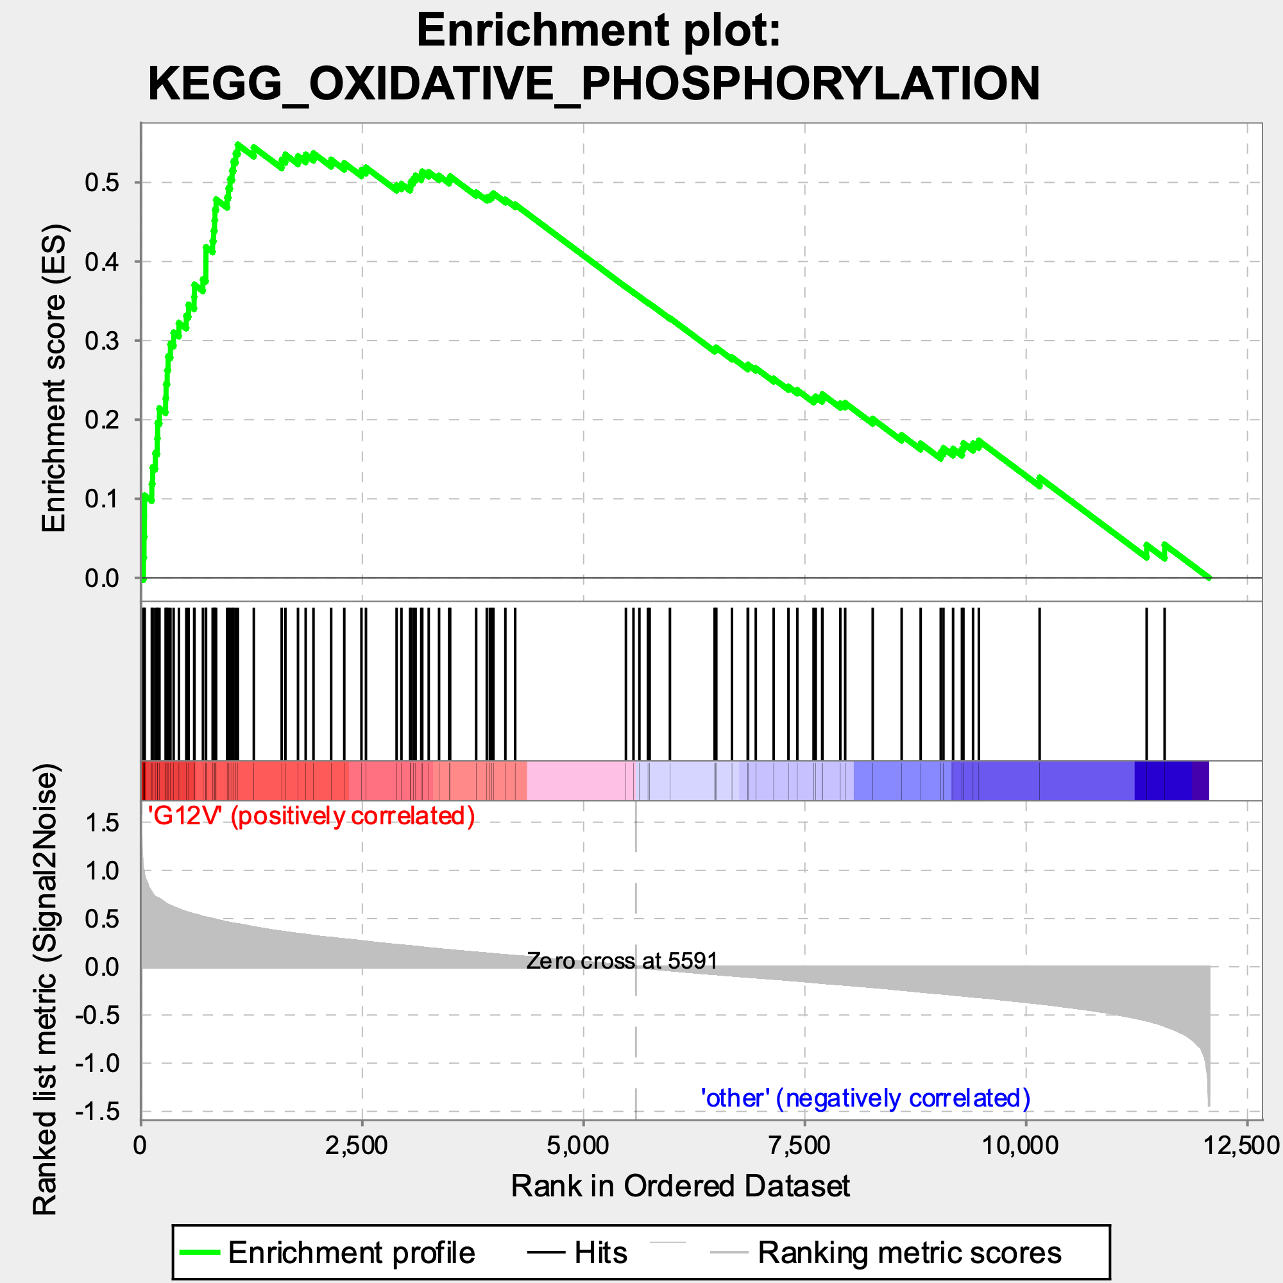
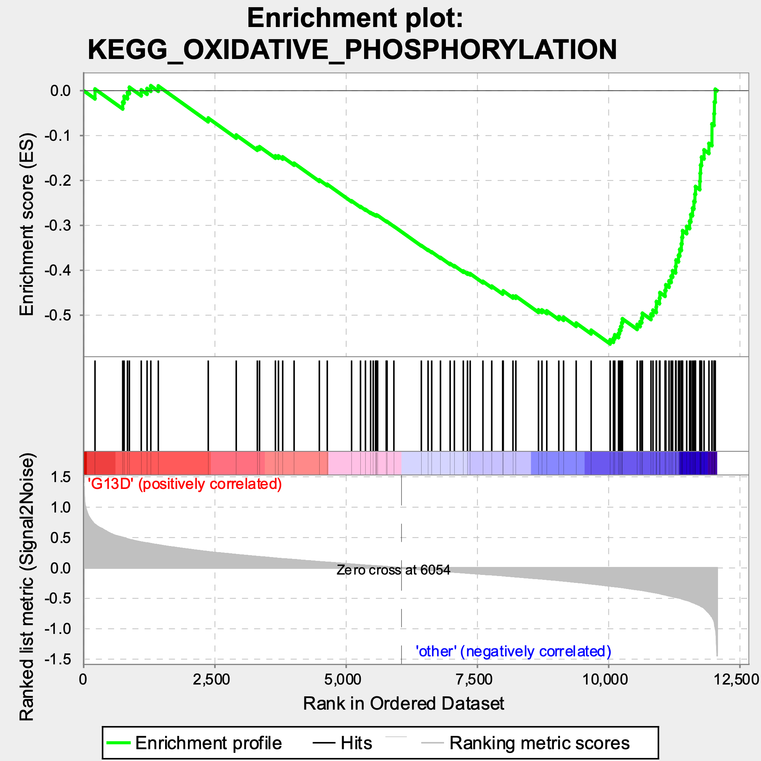
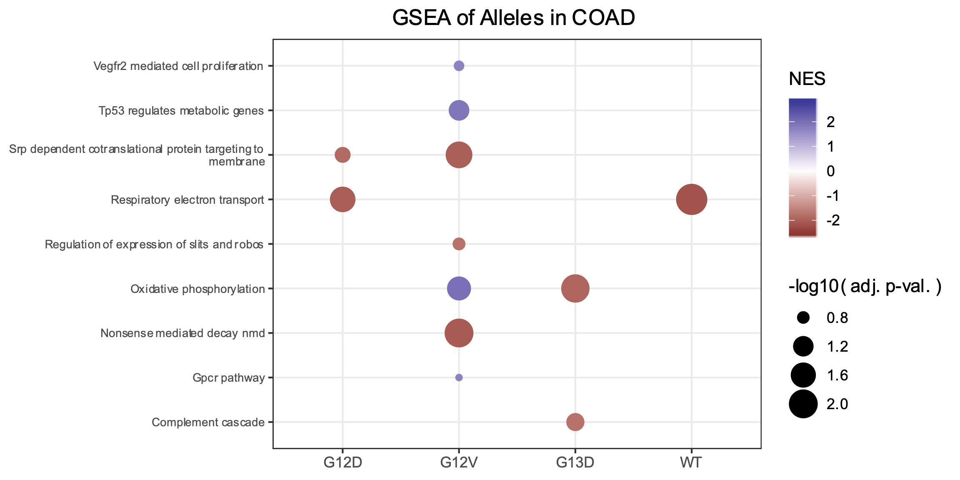
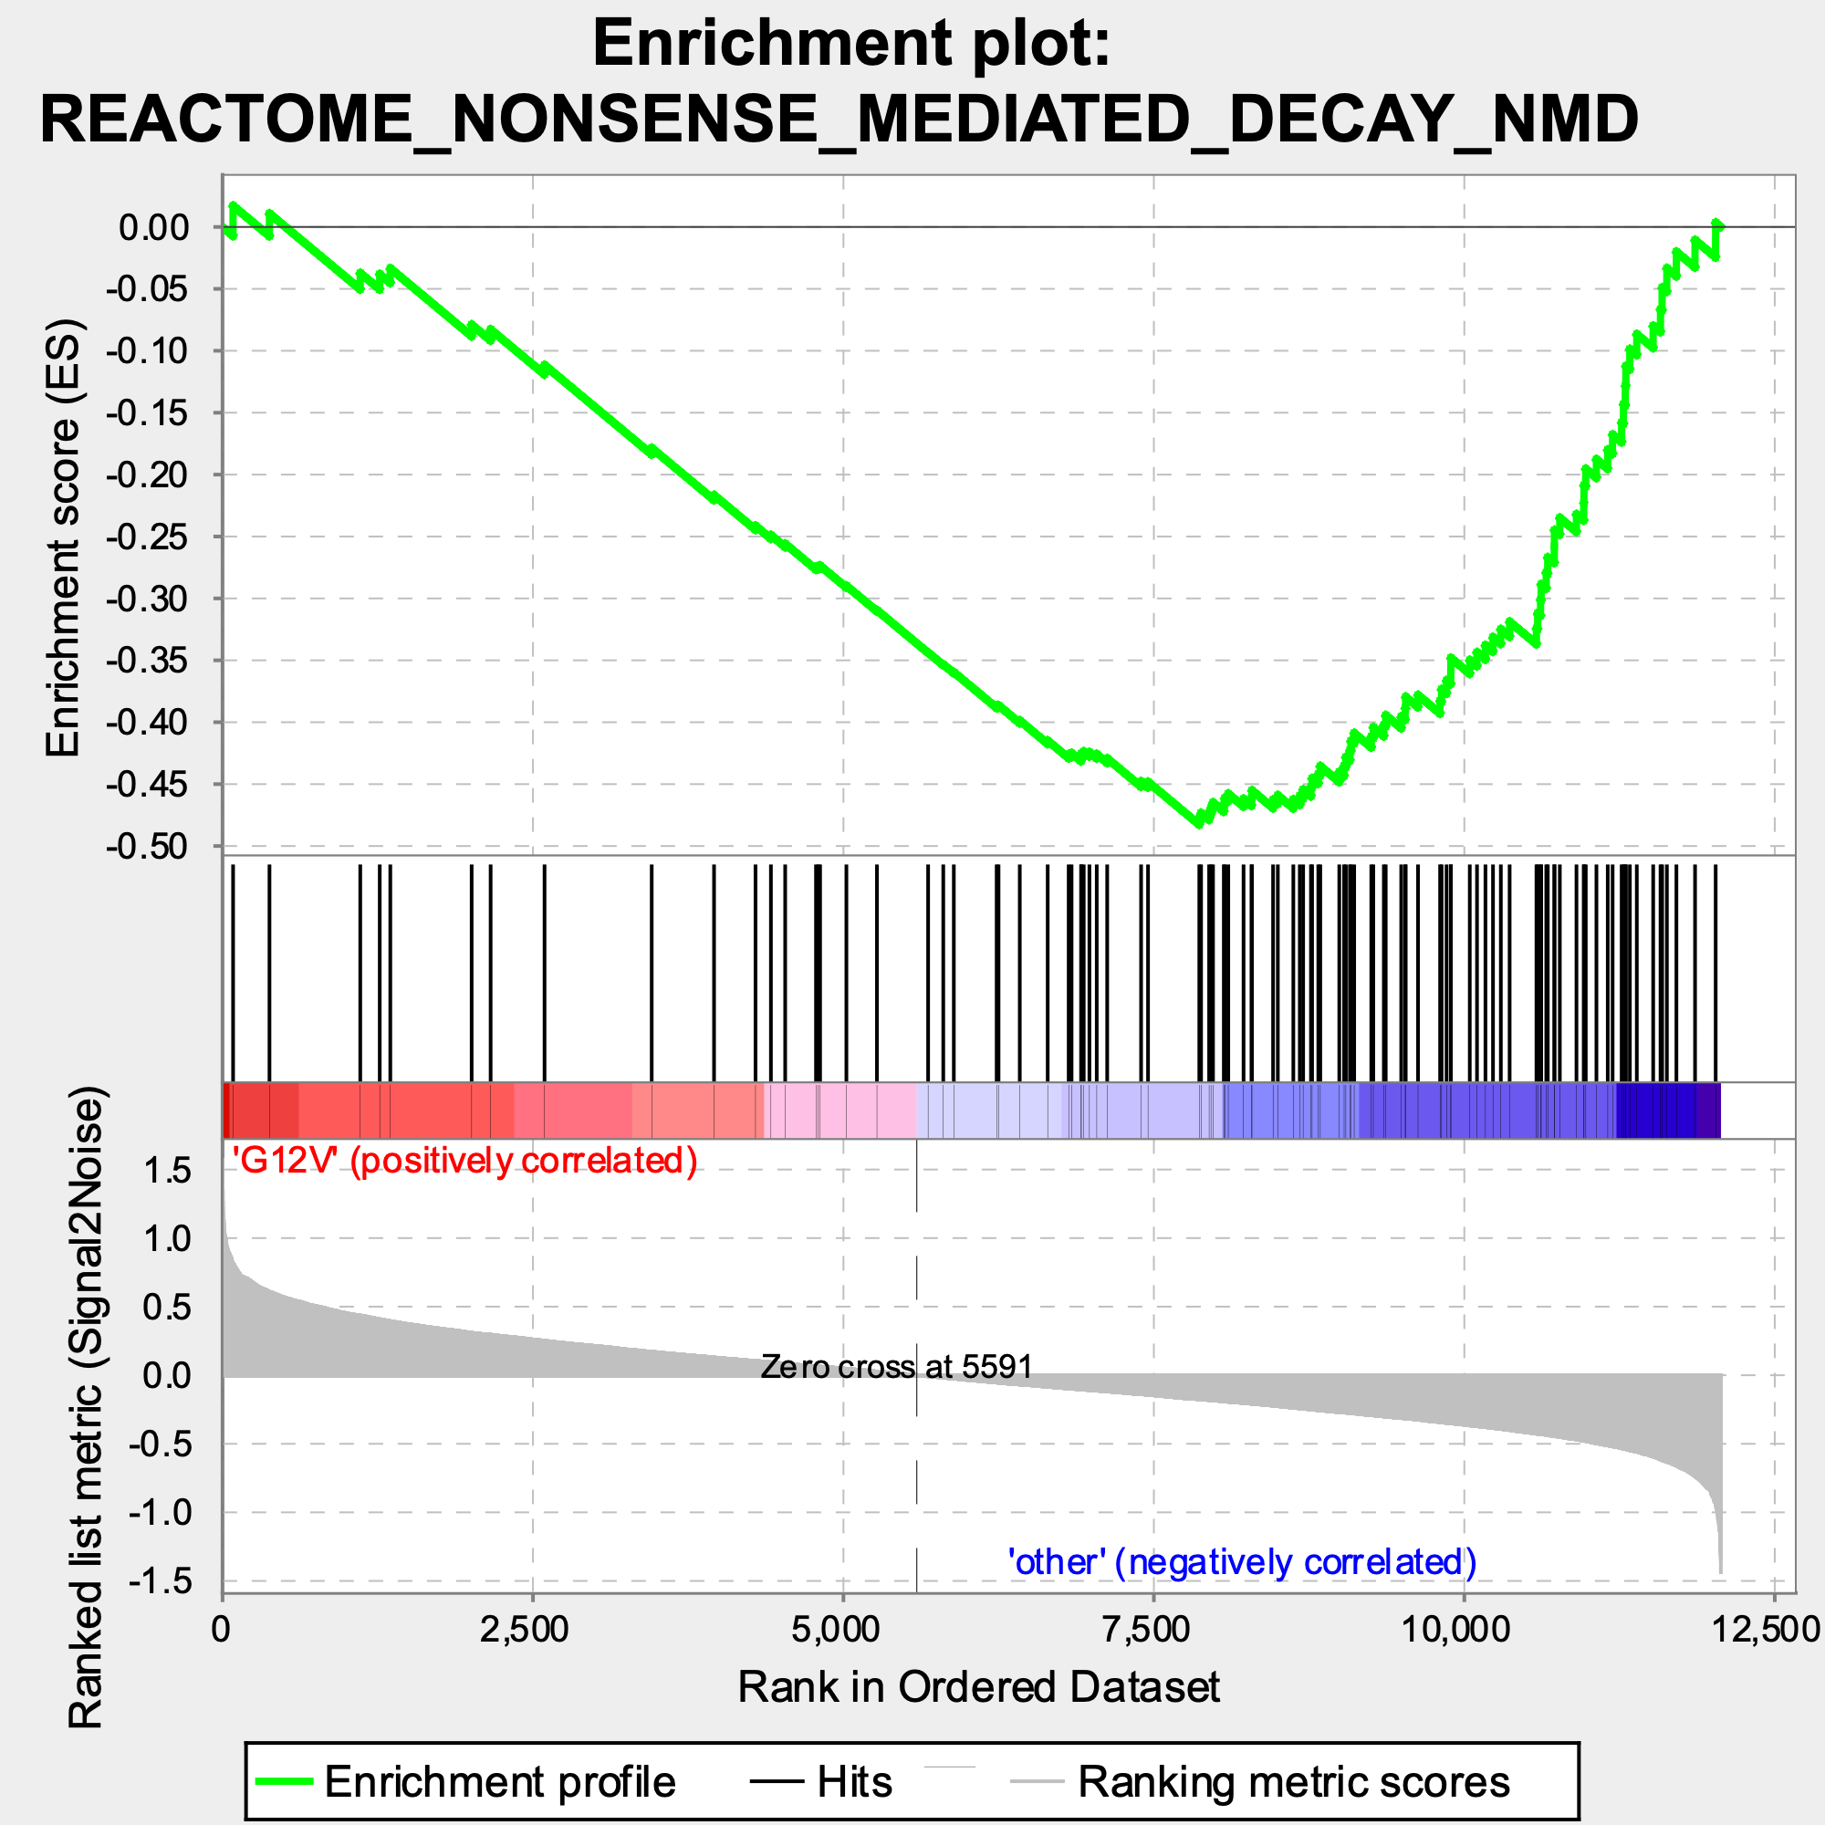
KRAS allele-specific dependencies: COAD
Less dependent
More dependent
Oxidative phosphorylation
Nonsense mediated decay (NMD)
Notes:
NMD: remove mRNA with early stop codons (nonsense mutations)

Slide 36
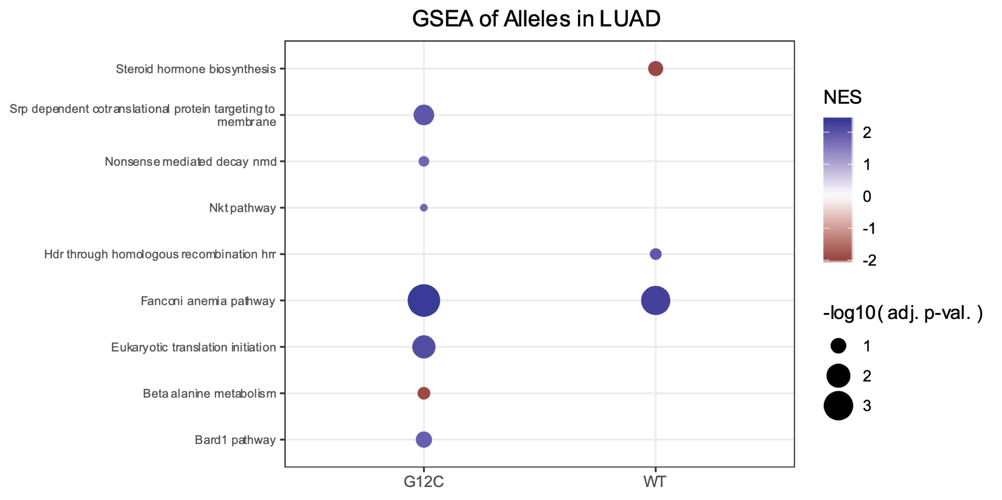
KRAS allele-specific dependencies: LUAD
Less dependent
More dependent
Notes:
Fanconi anemia pathway: required for efficient DNA repair
Bard1 pathway: tumor suppressor; usually associated with breast cancer because it heterodimerizes with BRCA1

Slide 37
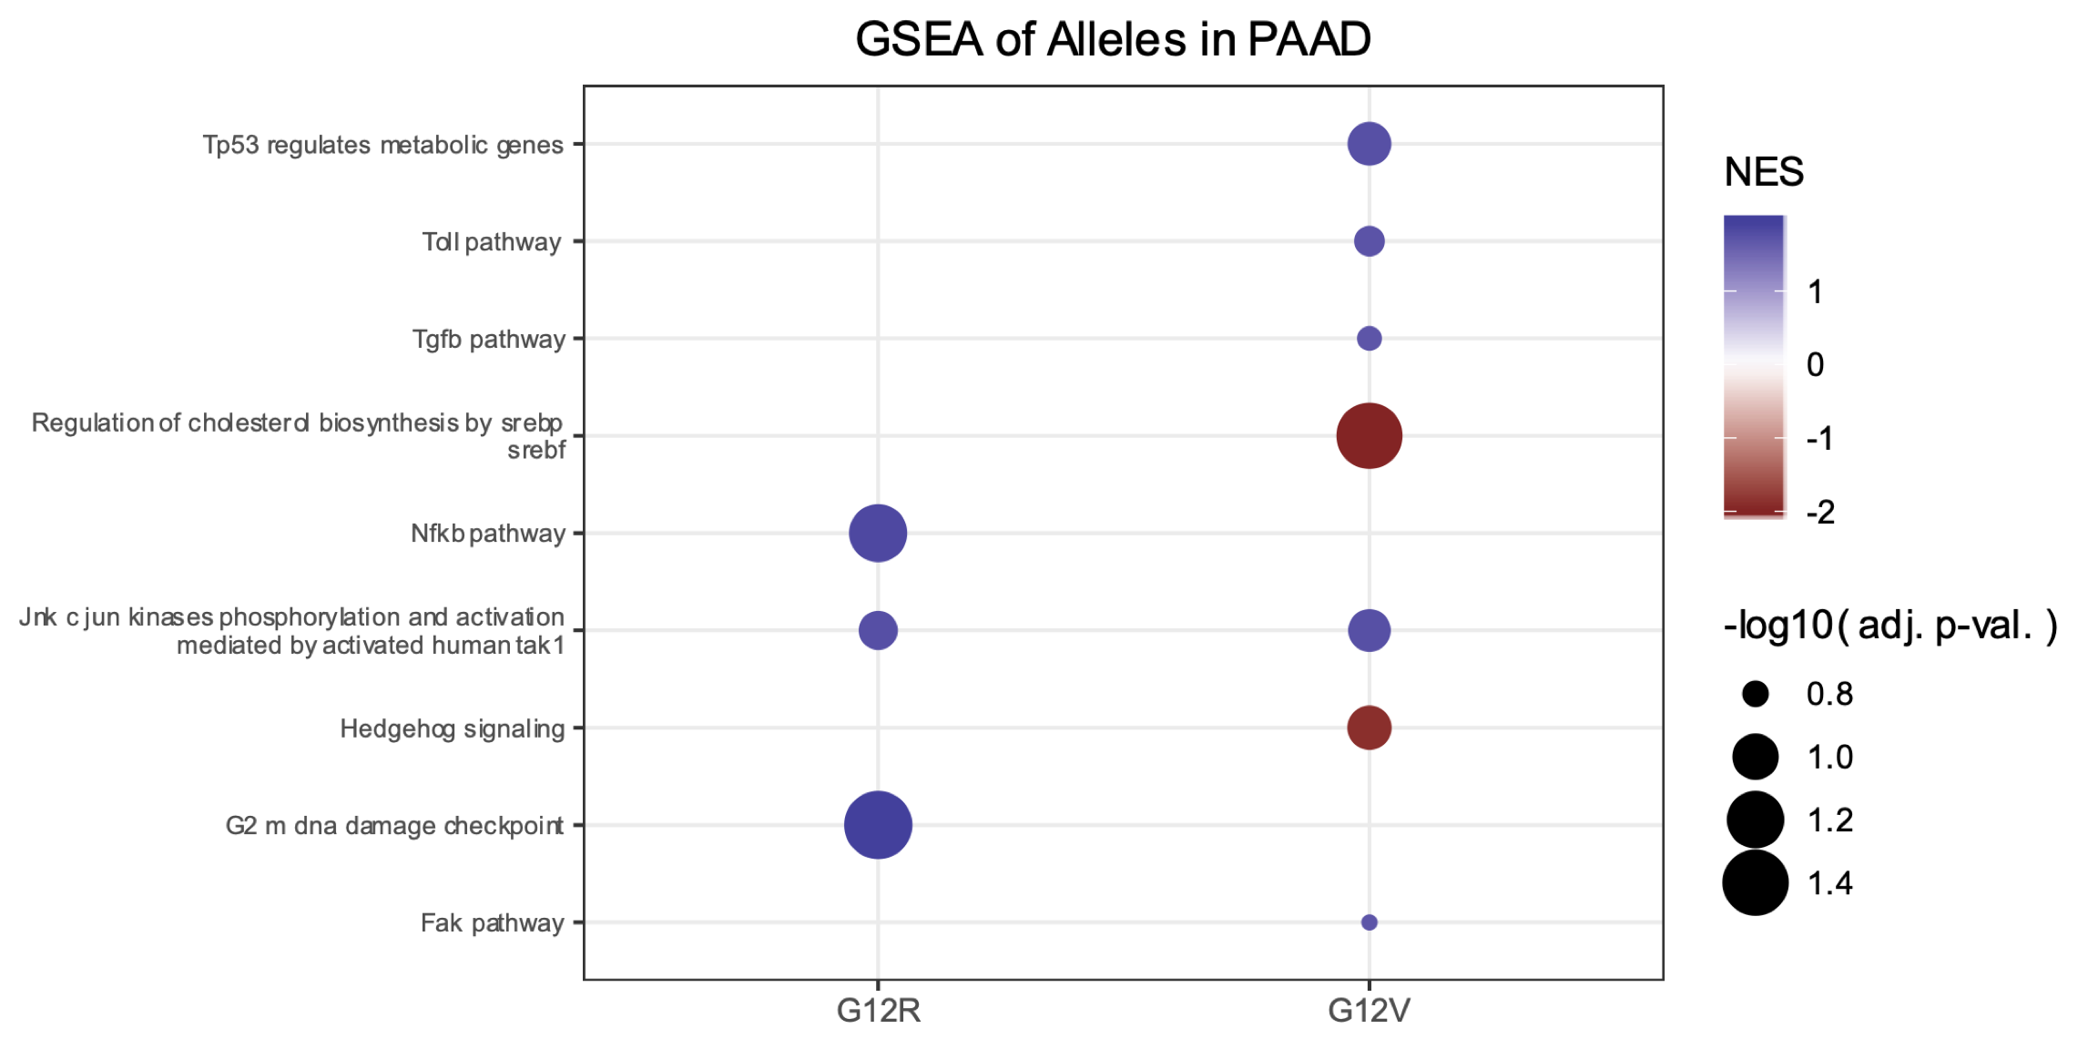
KRAS allele-specific dependencies: PAAD
Less dependent
More dependent
Notes:
What was the preparation of the data for GSEA. How did I scale the values?

Slide 38
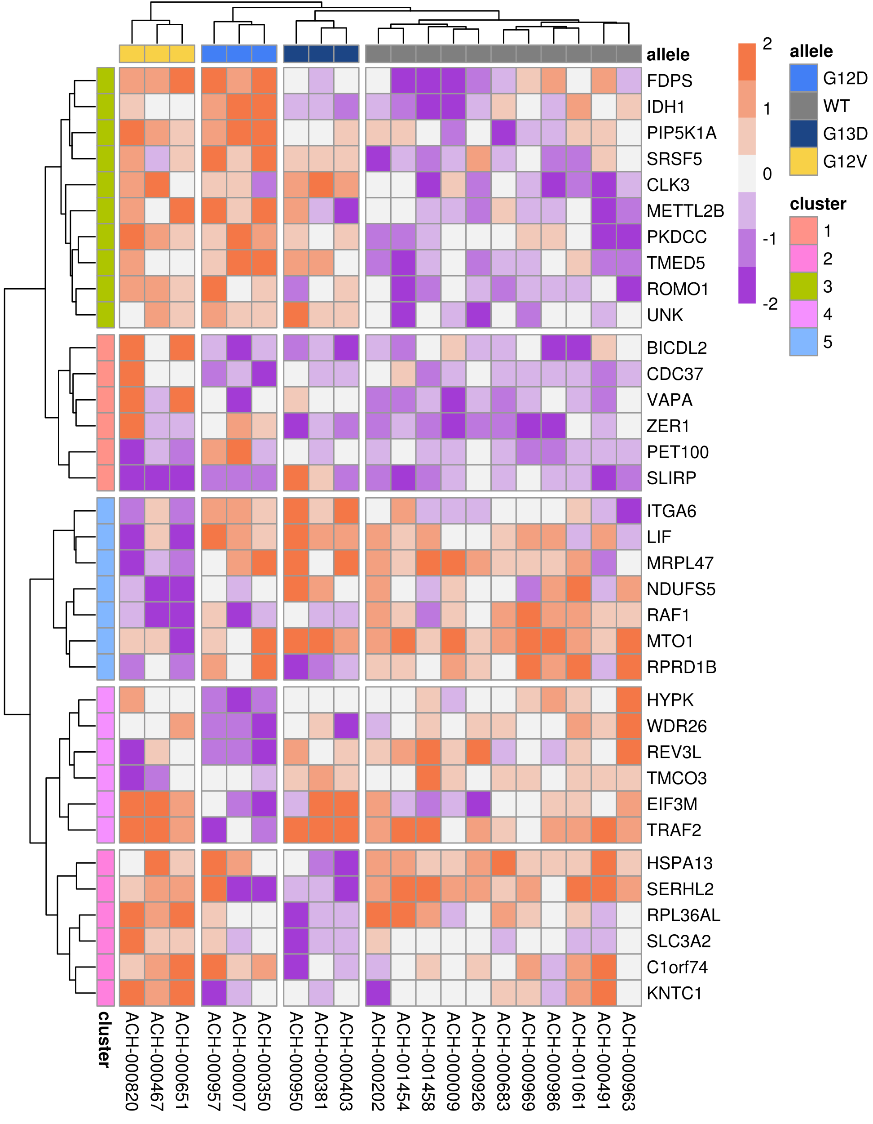
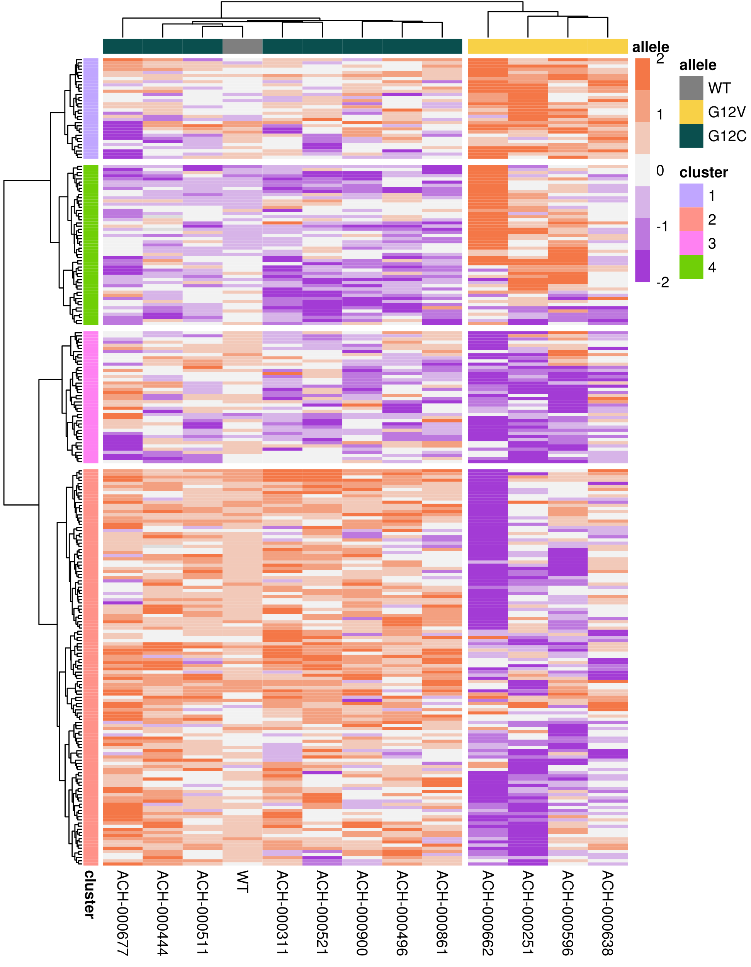
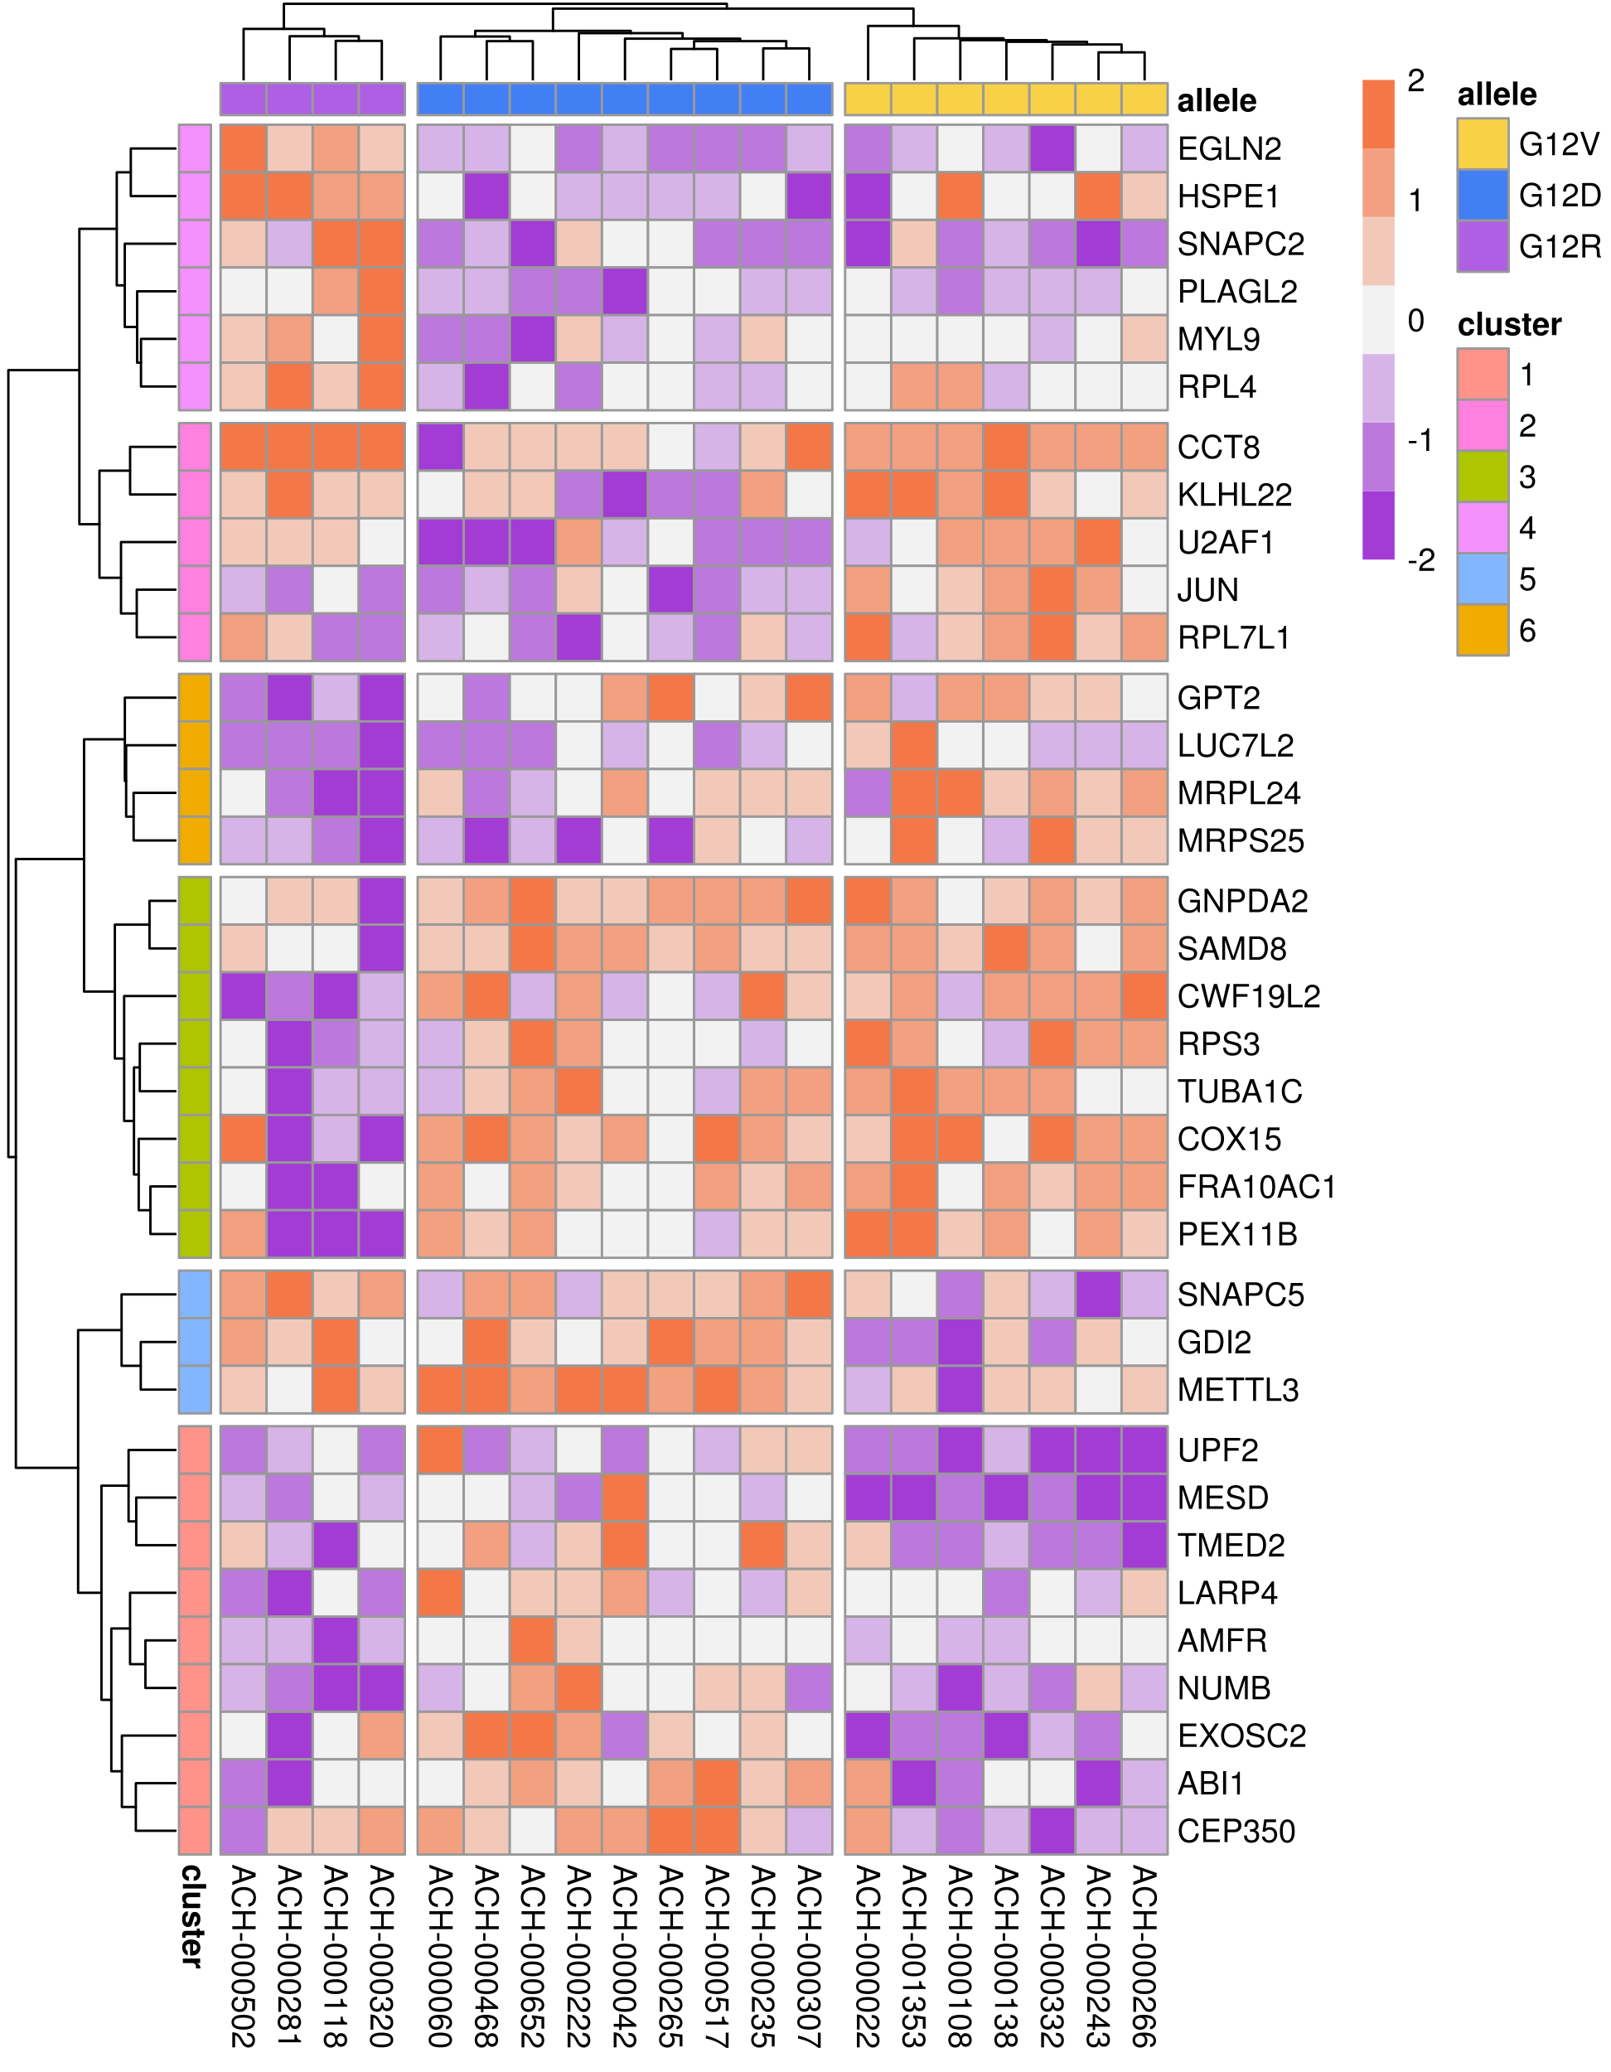
Allele-specific synthetic interactions in with KRAS
COAD
LUAD
PAAD

Slide 39




Allele-specific synthetic interactions in with KRAS
COAD
IDH1
PIP5K1A
WDR26
KNTC1
Notes:
IDH1:Isocitrate dehydrogenase (cytoplasmic)
PIP5K1A:
WDR26:G-beta-like protein involved in cell signal transduction; negative regulator of MAPK and Wnt
KNTC1: “Kinetochore-associated protein 1”; essential mitotic checkpoint

Slide 40
Are the comutation and dependency interactions related?
Notes:
Distribution of mutational signatures in the samples per allele

Slide 41


Comutation and dependency interactors: G12D in COAD
comutation
dependency
increased
reduced
more depletion
less depletion
Notes:
(I have the networks I want to use selected, but I need to re-run the script to fix some styling issues.)
For modules of comutation or mutual exclusivity: Fisher’s exact test for a mutation in any one of the genes
For modules of dependency differences: comparison of most vulnerable values in each cell line

Slide 42

Comutation and dependency interactors: G12V in COAD
comutation
dependency
increased
reduced
more depletion
less depletion
Notes:
(I have the networks I want to use selected, but I need to re-run the script to fix some styling issues.)
For modules of comutation or mutual exclusivity: Fisher’s exact test for a mutation in any one of the genes
For modules of dependency differences: comparison of most vulnerable values in each cell line

Slide 43
Comutation and dependency interactors: G12V in LUAD
comutation
dependency
increased
reduced
more depletion
less depletion
Notes:
(I have the networks I want to use selected, but I need to re-run the script to fix some styling issues.)
For modules of comutation or mutual exclusivity: Fisher’s exact test for a mutation in any one of the genes
For modules of dependency differences: comparison of most vulnerable values in each cell line

Slide 44

Comutation and dependency interactors: G12R in PAAD
comutation
dependency
increased
reduced
more depletion
less depletion
Notes:
(I have the networks I want to use selected, but I need to re-run the script to fix some styling issues.)
For modules of comutation or mutual exclusivity: Fisher’s exact test for a mutation in any one of the genes
For modules of dependency differences: comparison of most vulnerable values in each cell line

Slide 45
Conclusions
Mutational signatures cannot fully explain the KRAS allele frequency.
The KRAS alleles have shared and unique comutation interactions.
There are identifiable trends and specific instances of allele-specific genetic dependencies.
These form clusters in the PPI network, suggesting they are functional subunits.
Notes:
(I have the networks I want to use selected, but I need to re-run the script to fix some styling issues.)
For modules of comutation or mutual exclusivity: Fisher’s exact test for a mutation in any one of the genes
For modules of dependency differences: comparison of most vulnerable values in each cell line

Slide 46
Next Steps
Prioritize comutation interactions by the properties of the specific mutations or trends on the functions of the interactors.
Analyze the modules within the PPI subnetworks of comutation and dependency interactors.
Compare the PPI subnetworks across the alleles.
Notes:
For modules of comutation or mutual exclusivity: Fisher’s exact test for a mutation in any one of the genes
For modules of dependency differences: comparison of most vulnerable values in each cell line

Slide 47


Thank you

